Slide 1



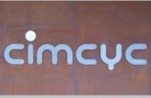

Oral Communication:
COGNITIVE REHABILITATION IN HIV PATIENTS. PILOT STUDY
García-Torres A^{1,2}, Vergara-Moragues E^{2,3}, Piñón-Blanco A⁴, Vergara-de Campos A², Pérez-García M¹
¹Centro de investigación Mente, Cerebro y Comportamiento (CIMCYC). Universidad de Granada.
² Hogar GERASA. Unidad de enfermedades infecciosas Hospital de Puerto Real(Cádiz).
³ Departamento de Educación. Universidad Internacional de la Rioja (UNIR).
⁴ Unidad Asistencial de drogodependencias del Concello de Vigo-CEDRO.
amalia.garcia.torres@gmail.com

Slide 2


BACKGROUND
Cognitive neurorehabilitation: useful in other samples with cognitive impairment.
brain injury (Cicerone et al., 2011)
schizophrenia (Dickinson et al., 2010)
Few studies in HIV population.
Increased risk of mortality
(Lescure et al., 2011)
HAND
Job loss (Rueda et al., 2010)
Difficulties in daily functioning (Letendre et al., 2010)
Quality of life (Tozzi et al., 2004)
Reduced adherence to treatment (Waldrop-Valverde, 2014)
Higher probability of dementia (Dore et al., 2000)

Slide 3
BACKGROUND
Cognitive intervention studies in HIV patients
 | Sample | Intervention | Evaluation design | N | Duration
Boivin et al., 2010 | Children | computerized | randomized | 60 (28 VIH+ control, 32 VIH+ experimental) | 10 sessions
Vance et al., 2012 | Middle-age and older Adults | computerized | randomized | 46 (22 VIH+ experimental, 24 VIH+ control) | 10 sessions
Becker et al., 2012 | Adults | computerized | randomized | 60 (30 VIH+, 30 VIH-) | 24 weeks

Slide 4
BACKGROUND
Exploratory study
The purpose of this exploratory study was to obtain pilot data from a group of HIV patients on the feasibility and efficacy of the neuropsychological program to determinate whether a larger, randomized trial is warranted.
Participants were recruited in Gerasa (Infectious Diseases Unit, Hospital Puerto Real, Cádiz).
Instruments: Neuropsychological battery, quality of life (MOS VIH), cognitive complaints, psychiatric symptoms (Anxiety and depressive scale (HADS), instrumental daily living questionnaire.
García-Torres, A., Vergara-Moragues, E. y Vergara-Moragues, A.(2014). Proyecto GALA: un estudio piloto de evaluación e intervención neuropsicológica en el Hogar GERASA,. En A. Piñón (Ed.). Juegos terapéuticos: El Trisquel. Concello de Vigo. ISBN 84-697-1941-6
Vergara-Moragues E., García-Torres A., Pérez-García M. (2014, abril). Alteraciones neuropsicológicas y funcionales en personas con problemas de consumo de sustancias y VIH, ¿es posible la intervención para su mejora?. Comunicación presentada en las XLI Jornadas nacionales de Socidrogalcohol. Sevilla.

Slide 5
Exploratory study
26 patients in GERASA
Meet inclusion criteria
No
Yes
12
14
Baseline assesment
Exclusion
Control group
7 patients
Experimental group
7 patients
Experimental
mortality
Post-test assesment
3 months:
4 patients
Experimental
mortality
Post-test assesment
3 months:
4 patients
3 derivations to another resource
2 derivations and 1 exitus

Slide 6
BACKGROUND
Exploratory study. Conclusions
Comparing the initial assessments of each subject with the final assesment, we note that the subjects in the experimental group improved more than the control in cognitive complaint, cognitive functioning and quality of life.
Qualitatively, the implementation of the program has been very positive in the dynamic center.

Slide 7
BACKGROUND
Current study. Objectives
To determine the effectiveness of implementing a neuropsychological program in people with HIV.
- Study the relationship between cognitive impairment and adherence to treatment.
- Study the relationship between cognitive complaints and cognitive impairment.
- Study possible interactions between cognitive functioning, everyday functioning and quality of life.

Slide 8
METHODS
Randomized, prospective study.
Participants are recruited in Infectious Diseases Unit, Hospital Puerto Real, Cádiz.
Exclusion criteria:
Illiterate
Psychiatric disorders
Current/active CNS opportunistic infections
Deaf or blind
History of neurological disease including dementia
Previous head trauma
Currently or recently in methadone maintenance programs.
Currently or recently in treatment with interferon for Hepatitis C.
Inclusion criteria:
- Age 18 to 65 years
HIV
Proficient in Spanish
No active drug/alcohol abuse or dependence
Informed consent

Slide 9
METHODS
Variables:
Demographic (age, gender, marital status, socioeconomic status, education level, criminal record, family support).
Clinical (time since HIV diagnosis, CD4 cell count, viral load and antiretroviral treatment). By physician.
Psychological
  Cognitive complaints (by self-reported check list. 7 areas: Concentration, reasoning, memory, learning, planning, communication,
hand movements)
  Depression and anxiety symptoms : Anxiety and depressive scale (HADS). By self-reported.
  Quality of life: MOS-HIV questionnaire. By self-reported.
  Instrumental activities of daily living (IADL) questionnaire. By self-reported.
  Treatment adherence scale: SERAD 1.1. By self-reported.

Slide 10
METHODS
Neuropsychological Battery
Cognitive Domains | Tests
Attention/working memory | - d2 - Digits (WMS)
Memory and learning | España-Complutense Verbal Learning Test (TAVEC) Brief Visuospatial Memory Test Revised (BVMT-R)
Speed information processing | - Symbol Digit Modalities Test - Trail Making Test A
Executive functions | - Tower of London Five Digits Trail Making Test B
Language | - Fhonetic verbal fluency: PMR - Semantic verbal fluency: Animals
Motor skills | - Grooved Pegboard - Tapping Test
Cognitive reserve: Vocabulary (WAIS)+ school years

Slide 11
METHODS.
Contact patients. Checkout inclusion/exclusion criteria. Informed consent
Screening: NEU
-
+
Exclusion
Baseline assesment: 200 patients
-
ANI
NMD
HAD
+
Exclusion
HAND
IADL
Participants randomized
Experimental group:
Neuropsychological program (50 patients)
Control group:
no therapeutic activities
(50 patients)
Post-test assesment
3 months
Follow-up assesment
6 months

Slide 12
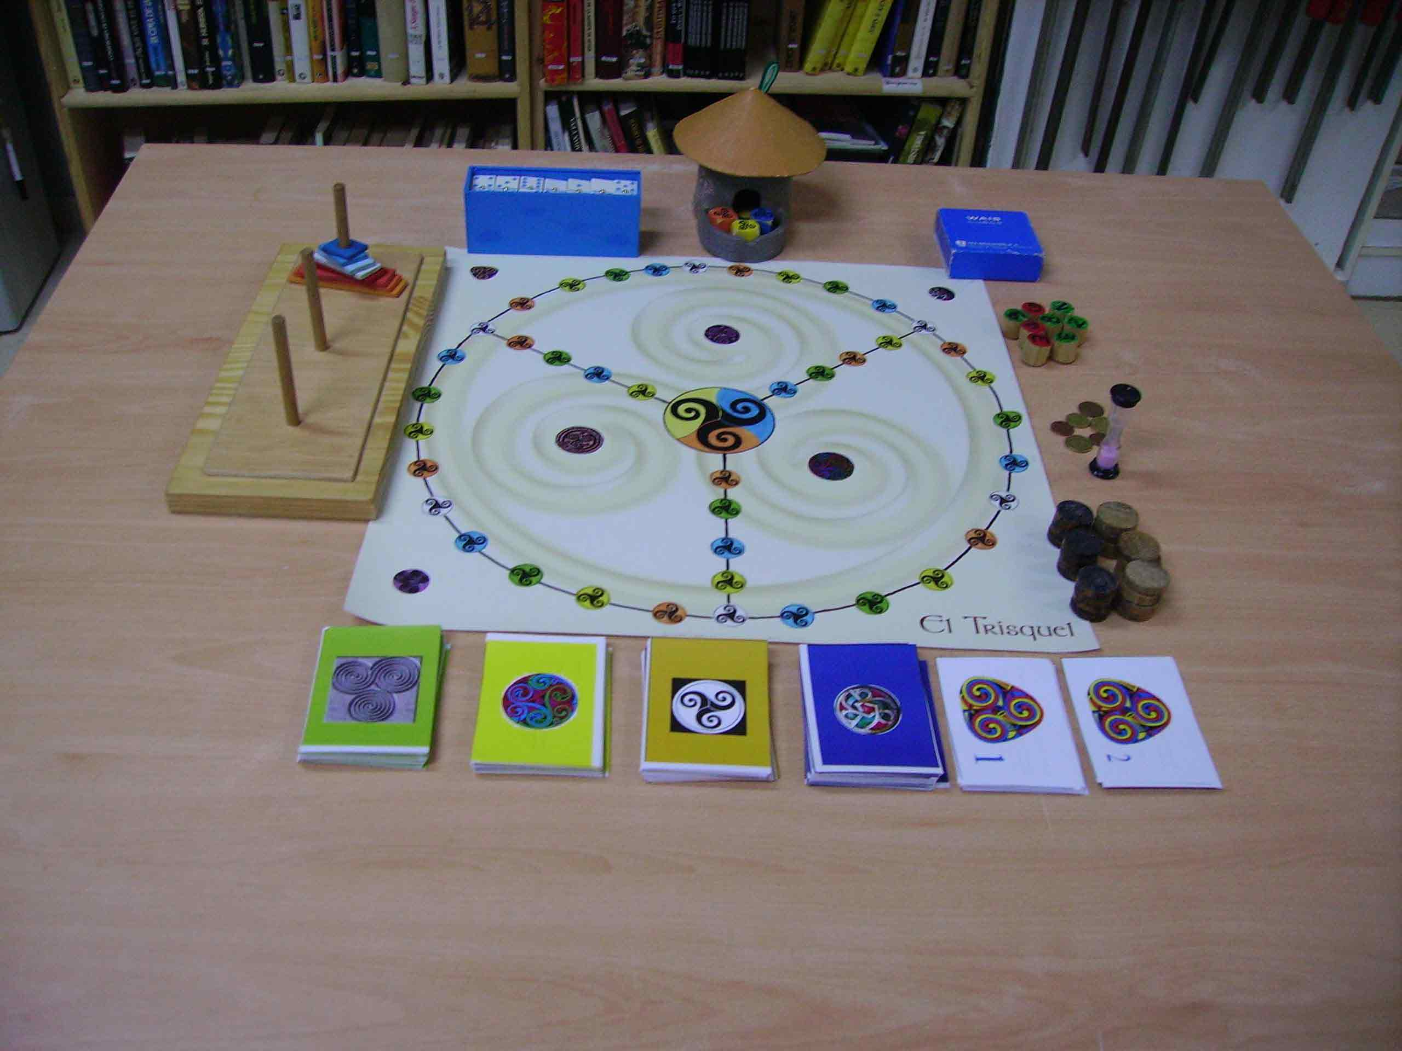
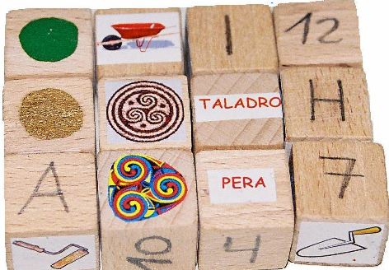
METHODS
Intervention Program
36 sessions (3 per week)
Adressed by a neuropsychology
Therapeutic games (Multitasking Cubes, Trisquel), computerized software.
All sessions structured
“Trisquel” (Piñón-Blanco, 2009)
“Multitasking Cubes” (Piñón-Blanco, 2010)
www.adolfopiñon.es

Slide 13
METHODS
Intervention Program
Therapeutic Module | Issues to work | Number of sessions
Self-awareness | Impact of deficits in daily life Adjustment expectation of future | 12
Restorative and compensatory techniques | Attentional subsystems Work memory Memory subsystems | 12
Executive functions and emotions | Decisions making Impulsivity Problem solving Emotional recognition | 12

Slide 14

CONCLUSIONS
The results of the exploratory study show that it is possible to use this type of neuropsychological program with HIV patients.
Our experience shows that the therapeutic games can be a dynamic tool to treat cognitive impairment and improve quality of life in HIV patients.
We are currently conducting the study with a large sample.

Slide 15
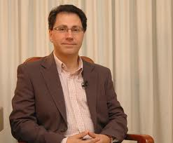

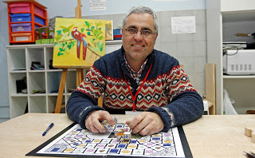

Acknowledgements:
Dr. Miguel Pérez García y grupo de investigación Neuropsicología e Neuroinmunología Clínica. Universidad de Granada
Dra. Esperanza Vergara
Universidad Internacional de la Rioja.
UEI Hospital Puerto Real
Adolfo Piñón y el equipo de CEDRO
Dr. Antonio Vergara de Campos y UEI Hospital Puerto Real

Slide 16
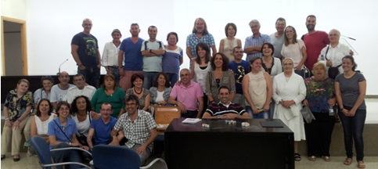
Acknowledgements:
Equipo terapéutico y pacientes de GERASA y Hospital de Puerto Real (Cádiz)
Colaboradores externos:
Dr. Jose Antonio Muñoz Moreno (Fundació Lluita contra la SIDA; Hospital Germans Trias i Pujol, Barcelona)
Dr. Ignacio Valero (Hospital La Paz, Madrid)
Alicia González (Hospital La Paz, Madrid)

