Slide 1





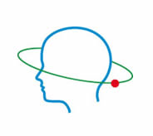

Neurocognitive and brain functioning among HIV-positive Young MSM treated with cART
Bogna Szymańska
Outpatient Clinic, Hospital for Infectious Diseases in Warsaw
Natalia Gawron, Agnieszka Pluta, Emilia Łojek, Andrzej Horban, Przemysław Bieńkowski, Robert Bornstein, et HARMONIA3 Study Group
8TH INTERNATIONAL SYMPOSIUM ON NEUROPSYCHIATRY & HIV
Barcelona, June 12-13th, 2015

Slide 2
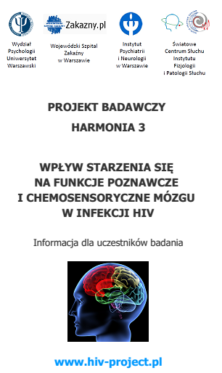



HARMONIA3
The Effect of Age
on Cognitive and Chemosensory Functioning of the Brain in HIV Infection.
Principal of Study: Ph.D. Emilia Łojek
The interdisciplinary team of researchers:
The Faculty of Psychology, University of Warsaw
Hospital for Infectious Diseases in Warsaw
Bioimaging Research Center, Institute of Physiology and Pathology of Hearing
Psychiatry and Neurology Institute in Warsaw
The Study was granted by National Science Center in Poland

Slide 3
INTRODUCTION
Neurocognitive and brain dysfunctions can still be observed in HIV-infected individuals, despite the successful antiretroviral treatment.
Currently, one of the largest HIV–infected groups are Young MSM (unaids.org)
There are many reports of neuropsychological disorders and HAND among the entire population of people infected with HIV.
However, there are no reports available focused only on Young MSM.

Slide 4
OBJECTIVE
The aim of the current report is to investigate on the neurocognitive and brain functioning of Young HIV(+) MSM, treated with cART, with undetectable HIV1-RNA in serum.

Slide 5

METHOD
SELECTION
Medical interview
Psychological interview
NEURPOSYCHOLOGICAL BATTERY
LARYNGOLOGY AND NEUROLOGY EXAMINATIONS
fMRI and NEO-FFI
N-Back
1st step
2nd step
3rd step

Slide 6
METHOD
EXCLUSION CRITERIA:
PARTICIPANTS
Co-infection HIV/HCV
Active opportunistic diseases
< 12 years of education
Neurological diseases
Laryngological surgery in the past (nasal obstruction)
IDU and alcohol abuse
Kidney failure
Liver failure
Uncontrolled hypertension
Participants aged 25-35 years
All HIV(+) participants were:
with undetectable HIV-1 RNA viral load in serum
HIV diagnosed at least 1 year before the study
on cART minimum 10 months
HIV(+) and control group participants were selected according to age, education, other socio-demographic variables (alcohol abuse, single/couple status, place of origin / residence, dominant hand)

Slide 7
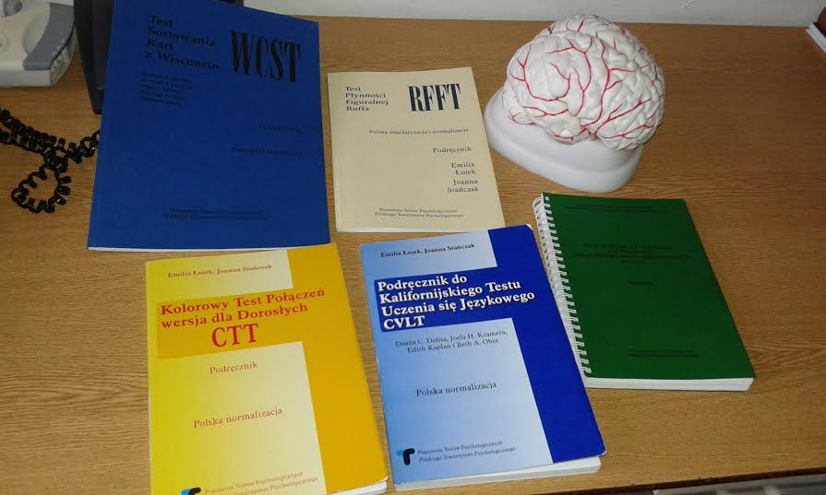
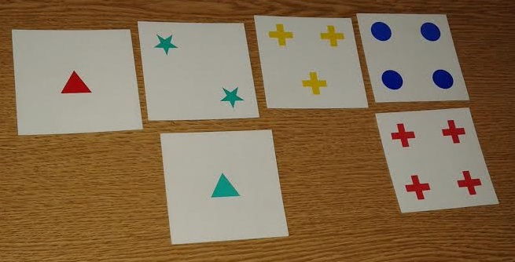
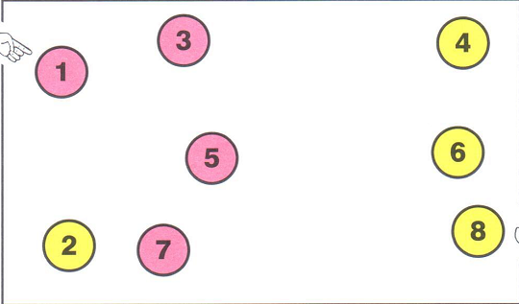
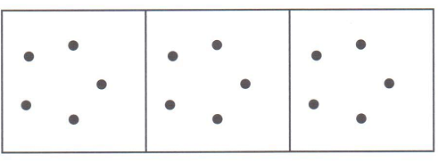
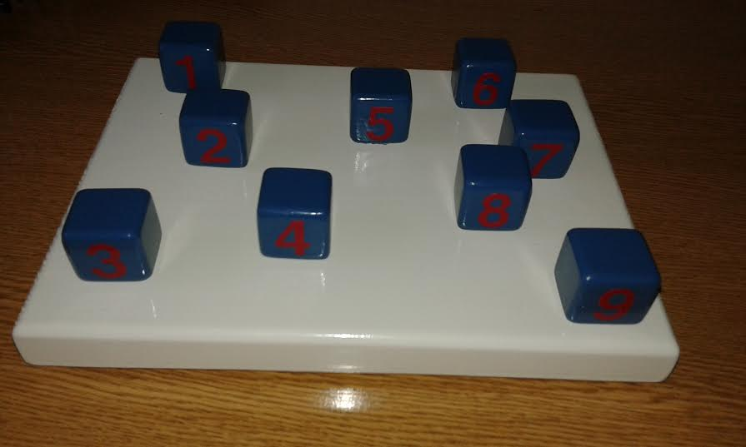
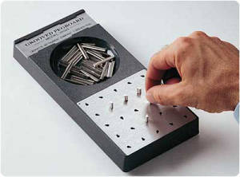
The participants performed:
1) battery of neuropsychological tests:
2) 11 psychological questionnaires
(mood / anxiety / QoL / personality task)
3) the n-back task in 3 Tesla MRI Scanner
Domain | NP tests
Visual memory | Block- Tapping Task forward/backward
Executive function | Block- Tapping Task backward CTT-2 RFFT WCST
Attention / Working memory | Block-Tapping CVLT Digit Span
Psychomotor abilities | CTT-1 Grooved Pegboard
Learning | CVLT
Language | Verbal Fluency Test (semantic fluency) Vocabulary

Slide 8
RESULTS
Demographics
 | HIV+ (N=32) M ± SD | HIV – (N=24) M ± SD
Age | 30.8 ± 3.7 | 29.7 ± 4
Years of education | 16.5 ± 2.7 | 17 ± 2.3
HIV(+) group - medical data
 |  | HIV + (N=32) M ± SD
Years since HIV detection |  | 3.4 ± 2.7
CD4+ count cells / µL | nadir | 314.5 ± 119.2
 | current | 600.5 ± 201.2
The highest HIV-1 RNA in life copies / µL |  | 262459.4 ± 666378.7
Years since cART |  | 2.5 ± 2.3

Slide 9
RESULTS
Neuropsychological Performance within the groups
Neuropsychological Test | HIV - N = 24 | HIV + N = 32 | p Value | Differences between groups
Visual Memory Span Forward | 9.7 ± 1.8 | 8.9 ± 1.6 | .07* | Control > HIV+
Visual Memory Span Backward | 9.4 ± 1.8 | 7.9 ± 1.3 | .001 | Control > HIV+
RFFT total unique designs | 109.2 ± 28.4 | 90.4 ± 19.3 | .005 | Control > HIV+
WCST total perseverative responses | 8.7 ± 8 | 12.4 ± 9.7
CTT 1 time in seconds | 34.3 ± 14.3 | 35.4 ± 10
CTT 2 time in seconds | 67.5 ± 18.5 | 72.3 ± 18.9
Grooved Pegboard dominant hand input | 68.5 ± 13.4 | 59.8 ± 6.2 | .006 | Control < HIV+
Grooved Pegboard non-dominant hand input | 71 ± 11.3 | 68.7 ± 7.8
Digit Span Forward | 6.9 ± 1.5 | 6.6 ± 1.8
Digit Span Backward | 8 ± 2 | 6.1 ± 1.8 | .001 | Control > HIV+
CVLT List A trial 1 | 8.2 ± 1.9 | 8.8 ± 1.9
WAIS-R (PL) Vocabulary | 48.9 ± 8.8 | 42 ± 9.8 | .009 | Control > HIV+
Verbal Fluency | 121.9 ± 21 | 112.7 ± 23.2

Slide 10
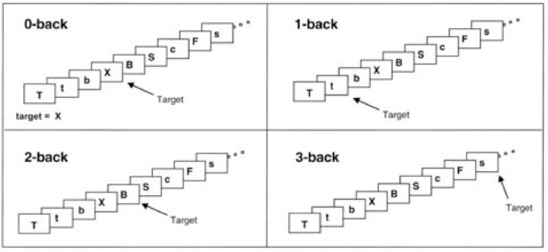
fMRI n-back task
HIV+ (N=19) | HIV – (N=15)
fMRI procedure
verbal working memory task (n-back)
Participants were instructed to monitor a series of stimuli and respond whenever a stimulus presented was the same as the one presented 0-, 1- and 2- trials previously.
The study was performed in the 3T MAGNETOM TRIO scanner. The fMRI parameters: 37 axial slices, echo-planar imaging pulse sequence, thickness/gap = 3/0 mm, inplane resolution = 64 x 64, TR = 2000 ms, TE = 30 ms, flip angle = 90, FOV = 192 x 192 mm.
All fMRI data processing was performed using SPM12 with standard analysis.

Slide 11
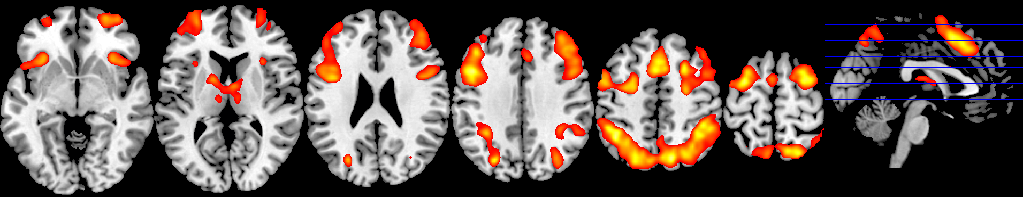

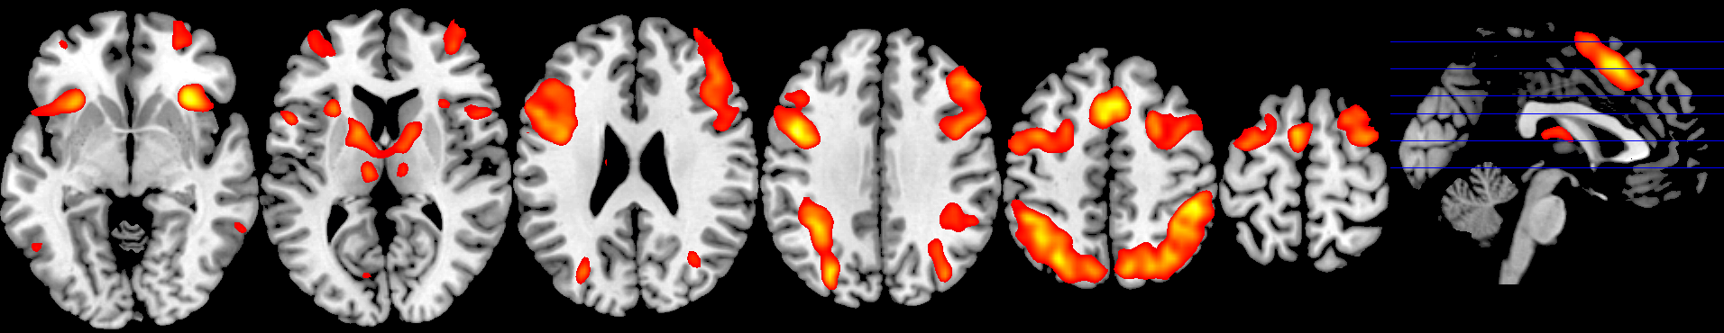

fMRI RESULTS
Control Group
HIV(+)
Clusters with T>5.12 (FWE corrected) are displayed in the activation image
Notes:
Clusters with T>5.12 (FWE corrected) are displayed in the activation image

Slide 12
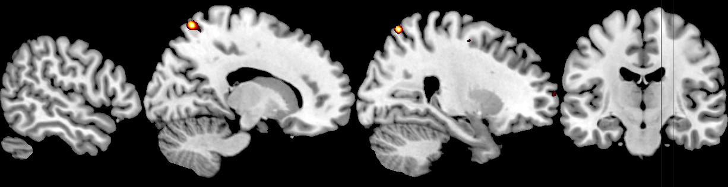
fMRI RESULTS
Control group > HIV(+)
The comparison between groups revealed higher activity in SPL in control group
Clusters with T>5.12 (FWE corrected) are displayed in the activation image

Slide 13
CONCLUSIONS
ANI
(HAND)

Slide 14
CONCLUSIONS
Some deficits in memory and executive domains were observed in Young HIV(+) MSM in comparison to control group.
Individuals in the control group were slower in a psycho-motor task than HIV(+) MSM.
During the fMRI task changes in brain activity were revealed among HIV(+) group.
Despite effective cART, HIV(+) MSM show slight changes in the neurocognitive and brain functioning comparing to the control group.

Slide 15

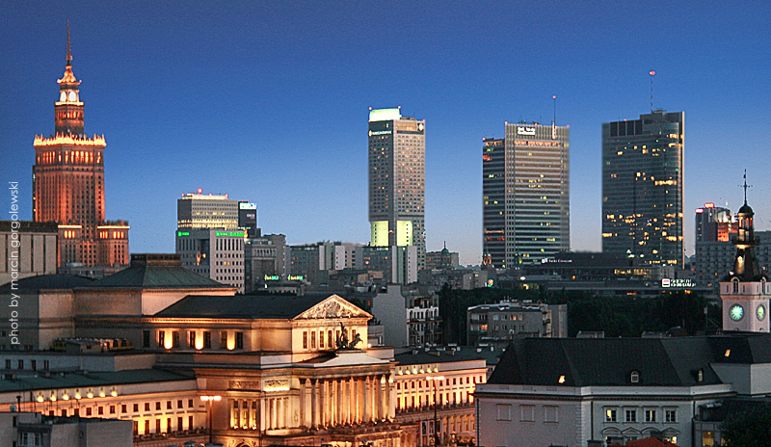
Prof. dr hab. Emilia Łojek
Agnieszka Pluta
Natalia Gawron
Marta Sobańska
Anna Ambroziak
Mateusz Choiński
Adela Desowska
Bogna Szymańska
Dr n. med. Ewa Firląg-Burkacka
Doc. hab. Andrzej Horban
Prof. dr hab. Przemysław Bieńkowski
Doc. hab. Halina Sienkiewicz-Jarosz
Dr n med. Anna Ścińska
Agnieszka Pluta
Dr inż. Tomasz Wolak
Inż. Mateusz Rusiniak
Prof. Robert Bornstein (Ohio State University)
Prof. Stephen Rao (Schey Center for Cognitive Neuroimaging , Cleveland Clinic, Neurological Istutute)

Slide 16
THANK YOU
FOR YOUR ATTENTION

