Slide 1



Alcohol Use in HIV-Infected Patients, Screening and Management
M Mercè Balcells
Alcohol Unit
Psychiatry Department
Neurosciences Institute
Hospital Clínic de Barcelona. IDIBAPS.
Barcelona, june 12-13th, 2015

Slide 2
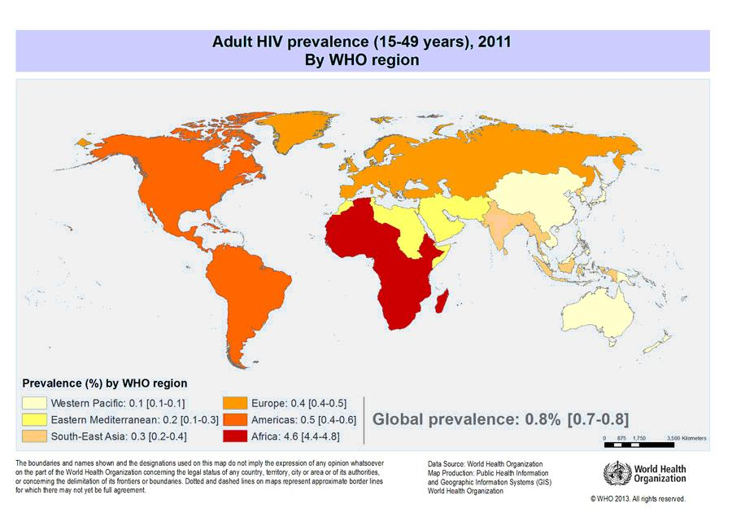
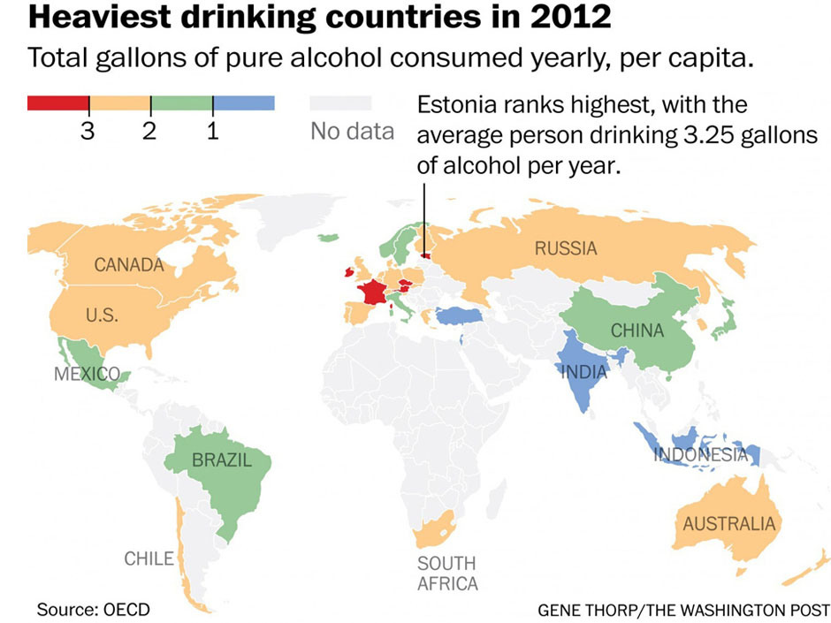
Alcohol use disorders (AUDs) and HIV
are both widespread global epidemics
Notes:
HIV/AIDS results in more than 2 million deaths annually (WHO, 2009).
Similarly, there are 1.8 million alcohol-related deaths annually world-wide (WHO, 2007).

Slide 3
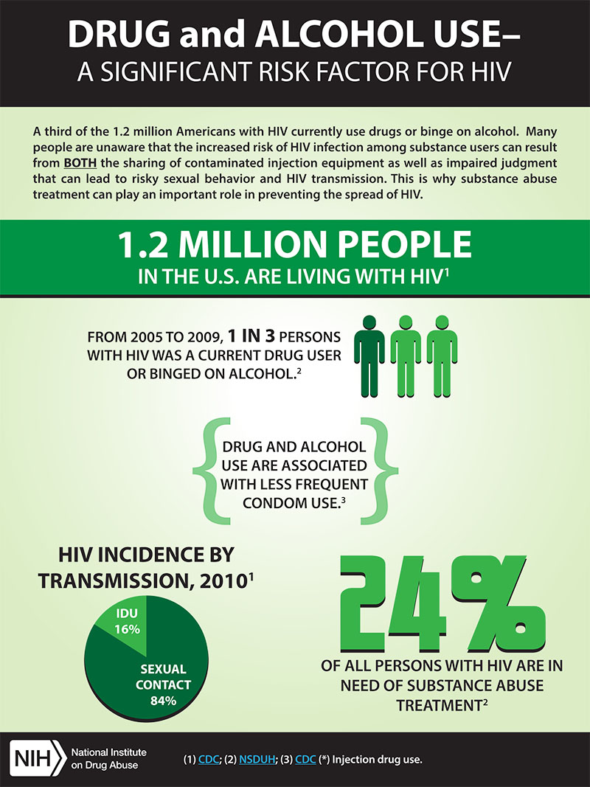
Notes:
AUDs and HIV are prevalent and each independently contribute negatively to poor health outcomes.
When combined, synergistic negative consequences result in increased morbidity and mortality.
The literature is complicated further by the added contribution of co-morbid mental illness, which is highly prevalent among both groups.

Slide 4
AUDs and HIV act synergistically :
Alcohol increases the risk of infection
Alcohol facilitates the progression of HIV
Alcohol decreases ART compliance
Alcohol decreases the proper use of health care resources

Slide 5
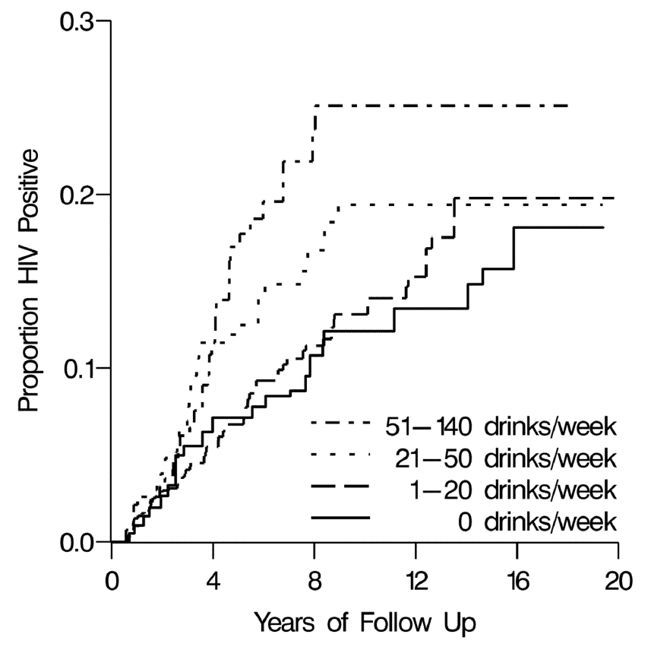
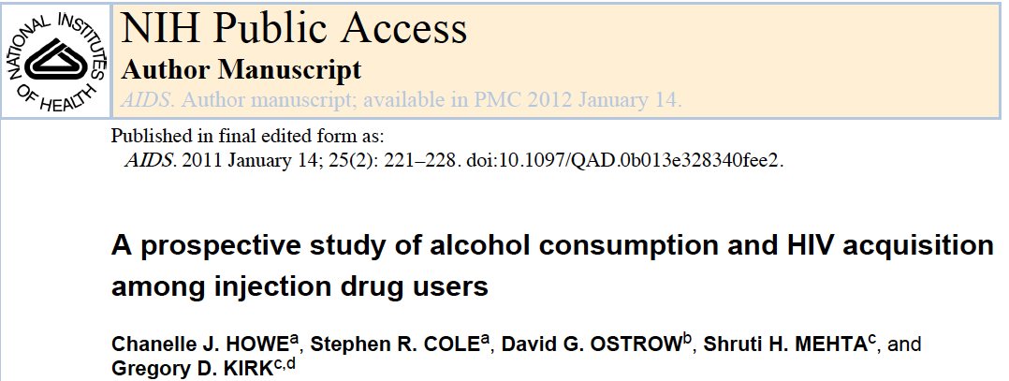
Proportion HIV positive by alcohol consumption (ALIVE study, n=1525)
Alcohol increses the risk of infection

Slide 6
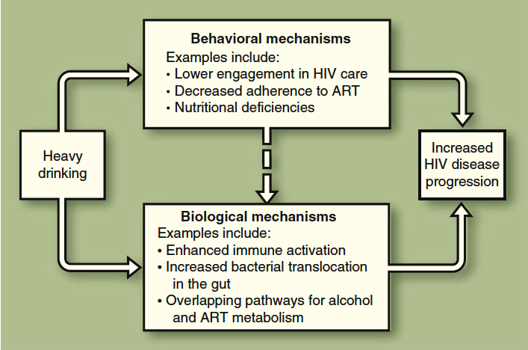
Alcohol facilitates the progression of HIV
Judith A. Hahn & Jeffrey H. Samet, 2010
Notes:
Alcohol facilitates the progression of HIV

Slide 7
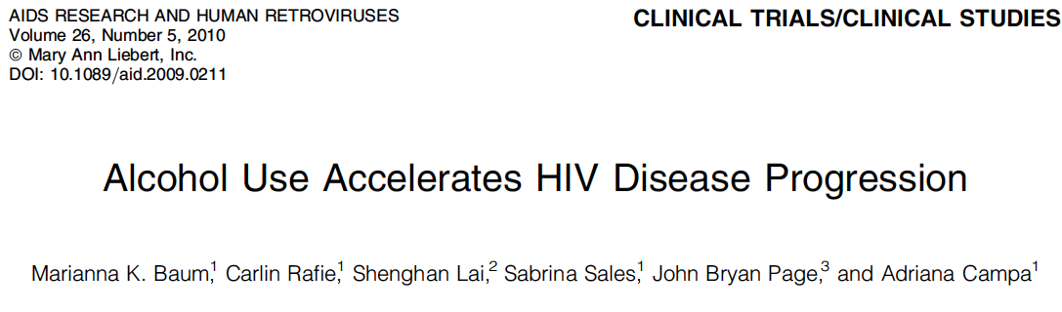
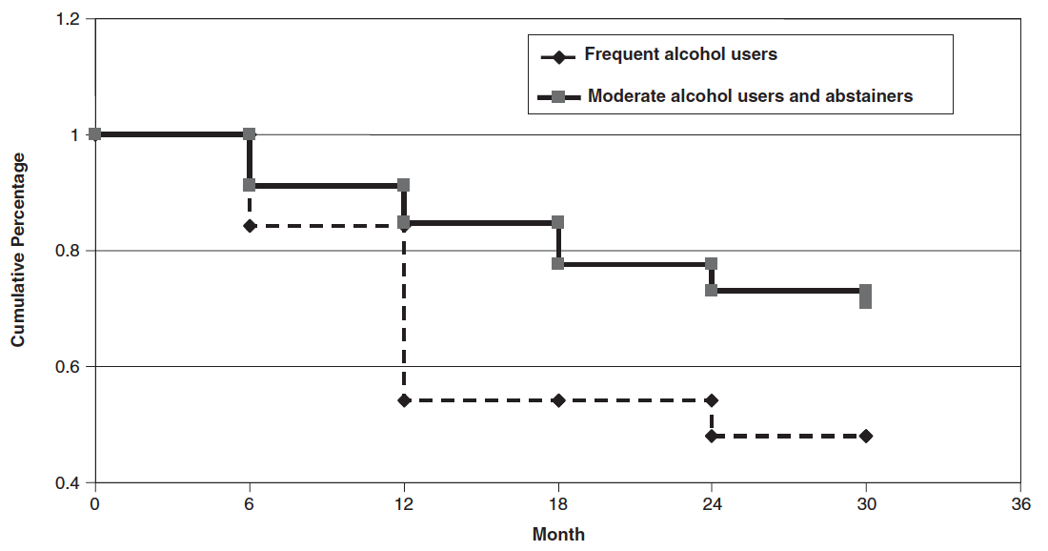
Alcohol facilitates the progression of HIV
231 HIV+ adults followed up prospectively during 30 months
Rate of decline of CD4þ cell count to 200 cells<µl
Notes:
Rate of decline of CD4þ cell count to 200 cells<µl

Slide 8
Alcohol and HIV treatment
The systematic review assessed the impact of AUDs on adherence to ART (N=20), health care utilization (N=11) and HIV treatment outcomes (N=10).
In general, and with some exceptions, AUDs negatively impact adherence to ART, health care utilization and HIV treatment outcomes.

Slide 9
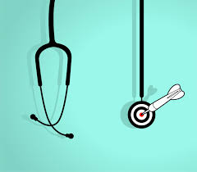
The need for action
Notes:
So with all these data it seems a good idea for clinicians to address and treate OH use in HIV patients

Slide 10
The unmed need for treatment
Past Alcohol Dependence. Treatment History:
EVER had treatment 25.5%
NEVER had treatment 74.5%
Treatment Examples:
Inpatient
Outpatient
Alcoholics Anonymous
Source: United States 2001-2002, NESARC data
Notes:
There is a huge unmet need in the treatment of alcohol dependency

Slide 11
There is a huge unmet need in the treatment of alcohol dependency
Treatment gap* (%)
Widest treatment gap among all mental disorders: Less than 10% of patients with alcohol abuse and dependence are treated
High prevalence and low treatment rates indicate a huge unmet medical need
Kohn et al. Bull World Health Organ 2004;82:858–866
Notes:
Less than 10% of patients with alcohol abuse and dependence are treated

Slide 12


Slide 13
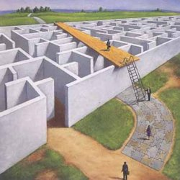

Diagnostic classifications
Notes:
Make it easer

Slide 14
Basic diagnostic classifications
WHO – ICD 10
APA – DSM-IVR
Hazardous drinking
Harmful drinking
Alcohol dependence
Alcohol abuse
Alcohol dependence
ICD 11 (?)
DSM V
Alcohol Use Disorder
Notes:
Given the empirical evidence, the DSM-V Substance Use Disorders Workgroup recommends:
To combine abuse and dependence into a single disorder
With graded clinical severity
Two criteria required to make a diagnosis

Slide 15
Alcohol Use Disorder (AUD)
Recurrent use resulting in a failure to fulfill major role obligations
Recurrent use in situations in which it is physically hazardous
Continued use despite persistent or recurrent problems caused or exacerbated by the effects of alcohol
Tolerance,
Withdrawal,
Alcohol is taken in larger amounts or over longer periods than intended
Persistent desire or unsuccessful efforts to cut down or control drinking
A great deal of time spent in alcohol-related activities
Important social, occupational, or recreational activities are given up or reduced because of drinking
Alcohol use is continued despite knowledge of having a problem probably caused or exacerbated by alcohol.
Craving or a strong desire or urge to drink alcohol.

Slide 16
Alcohol use disorder (AUD) (DSM V)
Severity specifiers:
Moderate: 2-3 criteria positive
Severe: 4 or more criteria positive
Specify Physiological Dependence:
tolerance and/or withdrawal

Slide 17
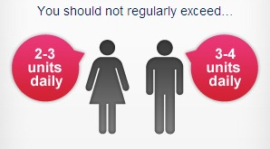
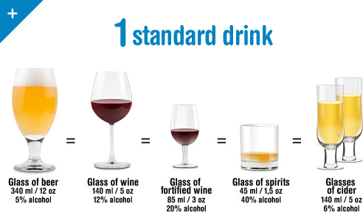
Hazardous drinking
Standard Drink Unit - 10gr OH -

Slide 18
The AUDIT-C
1. How often do you have a drink containing alcohol?
2. How many standard drinks containing alcohol do you have on a typical day when drinking?
3. How often do you have six or more drinks on one occasion
0) Never 1) Less than monthly 2) Monthly
3) Weekly 4) Daily or almost daily
Notes:
We can also use very simpel screenig test like the AUDIT C

Slide 19
The AUDIT-C
1. How often do you have a drink containing alcohol?
2. How many standard drinks containing alcohol do you have on a typical day when drinking?
3. How often do you have six or more drinks on one occasion
0) Never 1) Less than monthly 2) Monthly
3) Weekly 4) Daily or almost daily
Cut off point for Hazardous drinking:
4 or more in women
5 or more in men

Slide 20
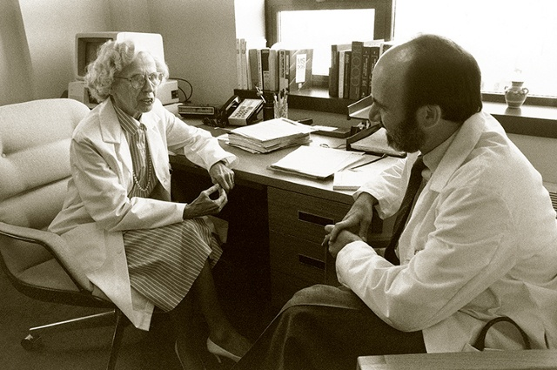
How to do it
Empathic style
Avoid judgmental attitudes
Stick to facts. Do not discuss why.
Don’t ask just about alcohol. Tobacco, BZD and illicit drugs are also relevant.
Notes:
And when you adress OH issues it is useful to remember to use a empathic style

Slide 21

Clinical management
Pharmacological treatments
Psychosocial treatments
Notes:
If we detect OH Use

Slide 22

Psychosocial treatments
Notes:
22

Slide 23
The confrontational model
Review of four decades of treatment outcome research.
A large body of trials found no therapeutic effect relative to control or comparison treatment conditions.
Several have reported harmful effects including increased drop-out, elevated and more rapid relapse.
This pattern is consistent across a variety of confrontational techniques tested.
In sum, there is not and never has been a scientific evidence base for the use of confrontational therapies.
WR. Miller, W. White; 2007

Slide 24
Motivational Interviewing
New golden standard for the psychological approach to addictive behaviours
Radical change:
external confrontation as a technique vs internal confrontation as a goal
Patient centered
Spirit: autonomy, evocation, empathy
Communication style: guiding

Slide 25
Brief Intervention
Empathic attitude
Promote self-efficacy
Assess
Feed-back results
Offer advice
Negotiate goals & strategies
Monitor progres
Respect Responsibility
Modified from Etheridge RM & Sullivan E. http://www.alcoholcme.com

Slide 26
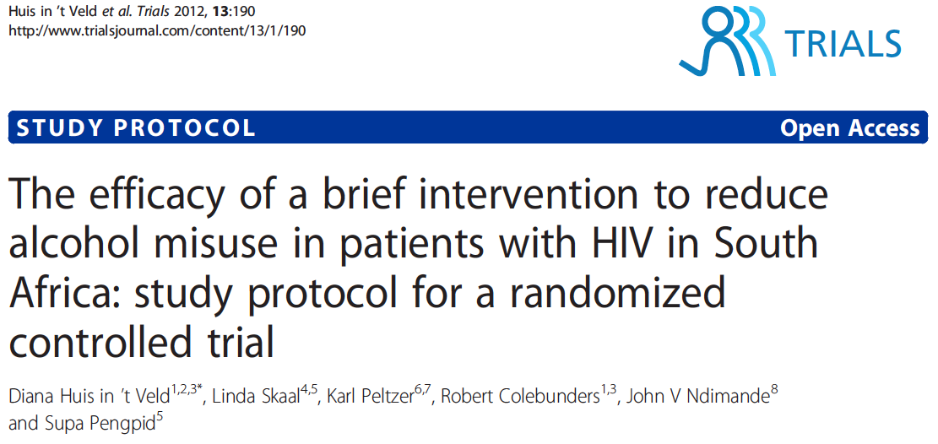
Alcohol Brief Interventions with HIV patients

Slide 27
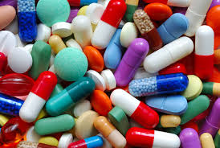
Drugs for the treatment of alcohol dependence
Disulfiram
Acamprosate
Naltrexone
Nalmefene
Topiramate
Gabapentine
Sodium Oxybate
Baclofen

Slide 28
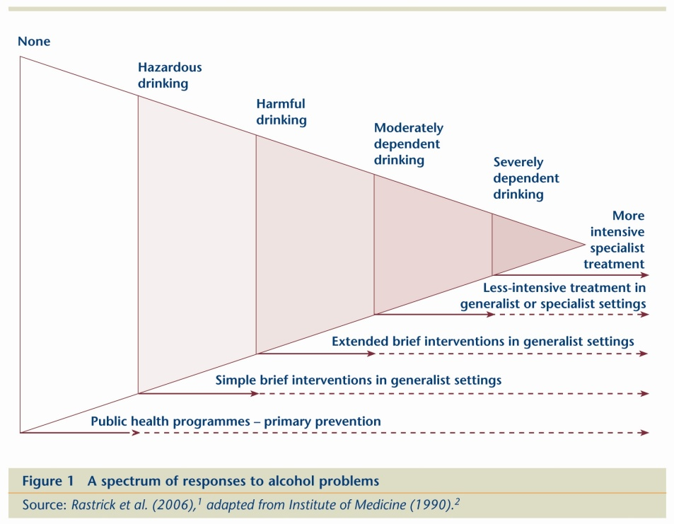
Drugs for the treatment of AUD
AUD vs OH dependence
Treatment of hazardous OH use
Focus on reduction vs abstinence

Slide 29
New drugs for AUD
Naltrexone
Reduces relapse rates. No effect on abstinence rates.
Decreases the rewarding effects of alcohol.
Nalmefene
Opioid modulator.
Recently approved by the EMA
Targeted use (‘as needed’)
Focus on reduction
Used jointly with psychosocial intervention

Slide 30

Case: Male 51 years old

Slide 31
Background
Male 51 years old
Opioid use disorder in remission
Cannabis use disorder in remission
Cocaine use disorder in remission
Alcohol use disorder active
HIV+
VC < 37
Col/TG: 229/163. T4 (43%): 819.
Mixed cognitive impairment (vascular/alcohol)
No other medical illness
Current treatment:
DRV/r 800/100 + rilpivirina.
Under alternative measures to incarceration
Low family support
Low incomes

Slide 32
Alcohol pattern of consumption
2 SDU x 3-4 occasions per week
Loss of control episodes (1 per month): heavy drinking use (> 20 SDU) during 2-4 days.
Consequences: black-outs, behavior disturbance, progressive worsen of cognitive impairment

Slide 33
Managment
Selincro®
Self-control and registre strategies
Motivational Interviewing

Slide 34
Conclusions
Alcohol and HIV are public health problems.
Alcohol has a negative impact on the progression of HIV and its treatment.
The prevalence of risky drinking in HIV population is high. Routine screening procedures are needed.
Brief interventions, psychosocial treatments and various drugs have shown efficacy in the treatment of alcohol use disorders.

Slide 35

Thank you!!!
mdbalcel@clinic.cat
Alcohol Unit
Psychiatry Department
Neurosciences Institute
Hospital Clínic de Barcelona

