Slide 1






Tobacco smoking
in HIV-infected persons.
Patrick Peretti-Watel
Inserm (French National Institute of Health and Medical Research)

Slide 2


Tobacco smoking
in HIV-infected persons.
I. Medical & epidemiological background.
II. Cigarette smoking: a sociological approach.
III. Why do HIV-infected people smoke?

Slide 3
I. Medical & epidemiological background.
Today, PLWHAs live longer…
Thanks to antiretroviral treatments (ART) since 1996;
but many of them smoke tobacco…
Smoking prevalence: 40-70% >> general population
+ higher levels of nicotine dependence;
…and smoking is especially harmful to PLWHAs
CVDs and (lung) cancers became major causes of mortality in this population.
HIV-infected smokers lose more life-years to smoking than to HIV (Helleberg et al., 2013, Clin Infect Dis)

Slide 4

I.1. Many PLWHAs smoke tobacco… (1/7)
PLWHAs smoke much more than the general population
comparing smoking prevalence according to serostatus requires first (at least) gender & age standardisation.
‘HIV-infected people’ is a very heterogeneous category, merging very contrasted profiles, including for smoking prevalence.
Health Barometer survey, general population aged 18-85, 2010, N=25,034 (INPES);
VESPA2 survey, national & representative survey, PLWHAs living in France, 18-88, 2011, N=3,022 (ANRS).

Slide 5
I.1. Many PLWHAs smoke tobacco… (2/7)
Health Barometer: 31% of smokers, mean age 48, 49% of men.
VESPA2 survey: 38% of smokers, mean age 47, 67% of men.
Among VESPA2 participants:
-people infected through homosexual intercourse (36%):
42% of smokers, mean age 48, 100% of men.
-people infected through intravenous drug use (10%):
78% of smokers, mean age 49, 70% of men.
-people infected through heterosexual intercourse (47%):
26% of smokers, mean age 46, 41% of men.

Slide 6
I.1. Many PLWHAs smoke tobacco… (3/7)
Smoking prevalence by gender and age for HIV-infected people and the general population, France, INPES 2010-ANRS 2011.

Slide 7
I.1. Many PLWHAs smoke tobacco… (4/7)
Smoking prevalence by gender and age for HIV-infected people and the general population, France, INPES 2010-ANRS 2011.

Slide 8
I.1. Many PLWHAs smoke tobacco… (5/7)
Smoking prevalence by gender and age for HIV-infected people and the general population, France, INPES 2010-ANRS 2011.

Slide 9
I.1. Many PLWHAs smoke tobacco… (6/7)
Smoking prevalence by gender and age for HIV-infected people and the general population, France, INPES 2010-ANRS 2011.

Slide 10
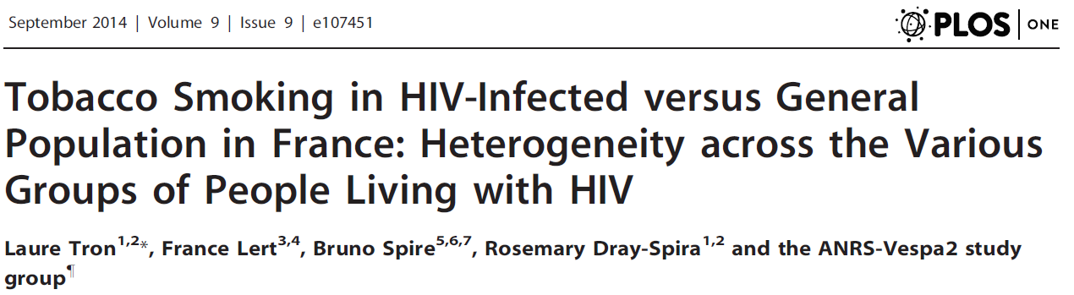
I.1. Many PLWHAs smoke tobacco… (7/7)
When compared to the general population, the smoking prevalence is higher among PLWHAs infected through homosexual intercourse, and much more higher among those infected through intravenous drug use.
See also:

Slide 11
I.2. Smoking is especially harmful to PLWHAS… (1/4)
Among PLWHAs, smoking increases the risk of:
CVDs, non-AIDS cancer, but also pneumocystis pneumonia, bacterial pneumonia, chronic obstructive pulmonary disease, oral candidiasis, emphysema, hairy leukoplakia... +ART side-effects / CVDs & cancer.
ART & AIDS: smoking → immune system impairment, increase in HIV replication, decreasing response to ART → virologic failure and disease progression.
Behavioural & attitudinal outcomes: HIV-infected smokers report lower medical adherence, attend fewer medical visits, and rank “health” as less important to their quality of life...

Slide 12
I.2. Smoking is especially harmful to PLWHAS… (2/4)
Behavioural & attitudinal outcomes: a focus on adherence to treatment & drug use.
Measuring independent effects for each drug use on adherence led to mixed and contradictory results.

Slide 13
I.2. Smoking is especially harmful to PLWHAS… (3/4)
→ VESPA survey 2003 (n=2484): investigating the relationships between drug use (cigarette, alcohol, cannabis, cocaine, heroin, drug maintenance treatment…) & adherence to HAART.
Two strategies:
#1: assessing independent effects for each drug use separately;
#2: first identifying patterns of drug uses with a cluster analysis, and assessing independent effects for each pattern separately.
#1→ cigarette smoking predictive of low adherence, no significant effect for cocaine or heroin use.
#2 → among other patterns, we found a “multiple addictions” profile (heroin+cocaine+DMT+tobacco) strongly associated to low adherence.

Slide 14
I.2. Smoking is especially harmful to PLWHAS… (4/4)
Cigarette smoking should not be considered as an independent risk factor, it is usually embedded in a lifestyle and connected with other behaviours/habits.
→ First step toward a sociological approach of cigarette smoking.

Slide 15
II. Cigarette smoking: a sociological approach.
II.1. Three basic principles of sociology.
II.2. Cigarette smoking as a social practice.
II.3. Smokers’ motives and justifications.
II.4. The social differentiation of smoking.

Slide 16
II.1. Three basic principles of sociology.
Situated/limited rationality: people pursue objectives, under specific circumstances, constraints, that must be understood.
Reflexivity: people are able/prone to stand back from their own experience to engage in reflexive thinking, in order to describe/explain/justify what they do → in-depth interviews…
Social groups: people are not isolated atoms in a vacuum. Their behaviours, attitudes and beliefs are constructed collectively, are influenced by their social environment → peers/colleagues/relatives with similar living conditions and values.

Slide 17
II.2. Cigarette smoking as a social practice. (1/3)
Not (only) a chronic, addictive and contagious disease: “tobacco pandemic”, “behavioural epidemic” through peer pressure/imitation & nicotine addiction →medicalization of smoking.
Considering cigarette smoking as a social practice implies a radical departure from this perspective.
We have to consider various aspects of cigarette smoking: implicit rules, know-how, meanings and motives...
These aspects are not personal attributes: they are shared with and learned from other smokers, and they change across time and space...

Slide 18

II.2. Cigarette smoking as a social practice. (2/3)
Social practice → learning process.
- how to hold the cigarette correctly,
- how to inhale/exhale properly,
- how to use tobacco as a psychological tool (as a sedative to alleviate stress, as a stimulant to counter boredom),
- implicit rules: in which circumstances, in which places, with which people, it is acceptable or not to smoke, or to ask for a cigarette...

Slide 19
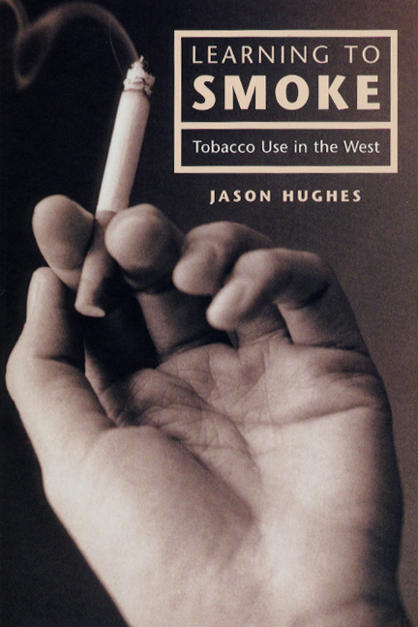

II.2. Cigarette smoking as a social practice. (3/3)
-

Slide 20
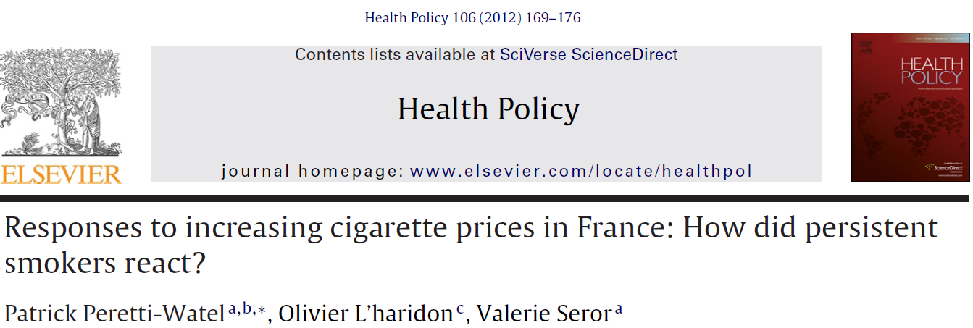
II.3. Smokers’ motives and justifications. (1/4)
Smokers’ motives and justifications.
Multiple benefits from smoking: feeling of membership, social bonding, relaxation, pleasure, dealing with periods of boredom/stress/sadness, regulating one’s weight...
These motives depend on personal smoking history, gender, age, socioeconomic status...

Slide 21
II.3. Smokers’ motives and justifications. (2/4)
Most common motives:
Reported reasons for smoking, from 1 (never) to 10 (always).

Slide 22

II.3. Smokers’ motives and justifications. (3/4)
Examples of justifications:

Slide 23
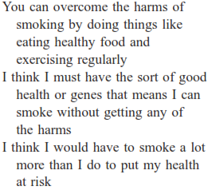
II.3. Smokers’ motives and justifications. (3/4)
Examples of justifications:

Slide 24
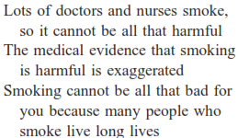
II.3. Smokers’ motives and justifications. (3/4)
Examples of justifications:

Slide 25


II.3. Smokers’ motives and justifications. (3/4)
Examples of justifications:

Slide 26
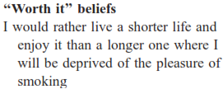
II.3. Smokers’ motives and justifications. (3/4)
Examples of justifications:

Slide 27
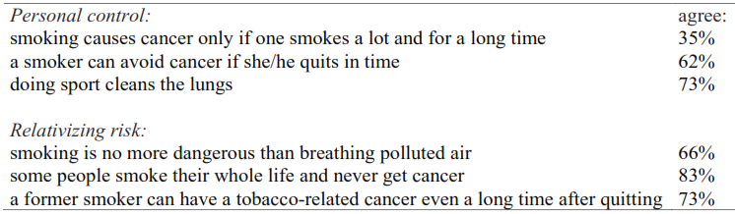
II.3. Smokers’ motives and justifications. (4/4)
Main risk denial beliefs among French smokers:
(Cancer Barometer survey, 2010, N=1,106 smokers, INPES)
Human beings are argumentative rather than strictly rational. They are prone to ‘convincing’ self-delusion.
Most smokers are neither ignorant of risk nor seeking it purposely. But they find ‘good reasons’ to deny/minimize it. Of course, they can be wrong. But taking this risk denial into consideration is necessary to improve prevention.

Slide 28
II.4. The social differentiation of smoking. (1/5)
Cigarette smoking, considered as a social practice, involves a whole set of beliefs, attitudes & behaviours, acquired through a learning process embedded in social context.
One important corollary:
social differentiation of smoking-related beliefs, attitudes and behaviours, & social differentiation of sensitivity to prevention.
Example: trends in smoking prevalence in France during the 2000s ( anti-tobacco policies & social differentiation of smoking prevalence).

Slide 29
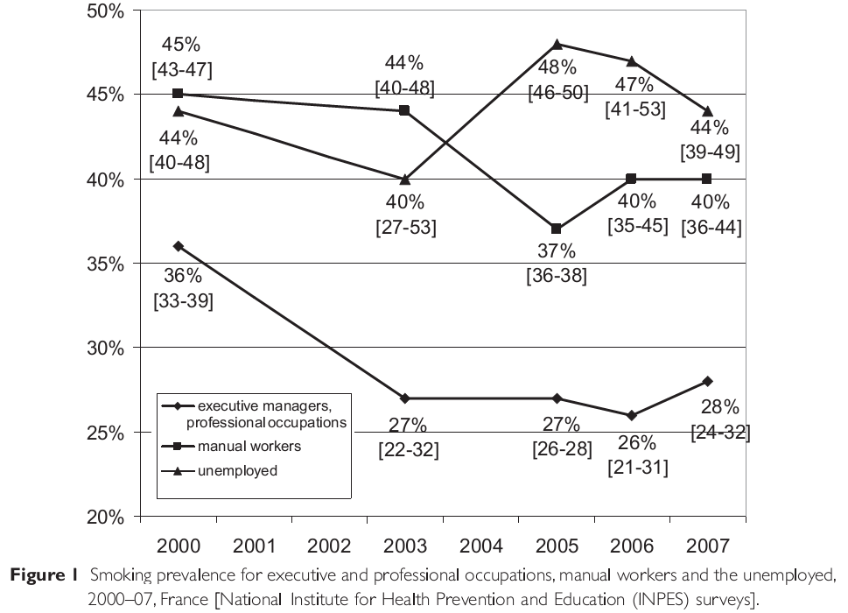
II.4. The social differentiation of smoking. (2/5)
(40-45)/45= -11%
(28-36)/36= -22%

Slide 30
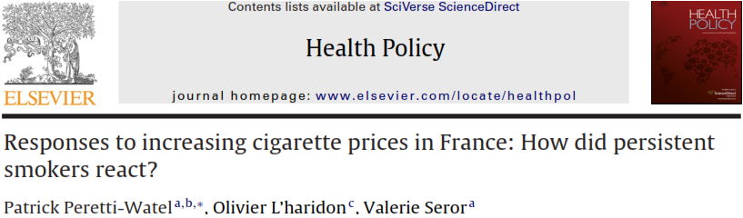
II.4. The social differentiation of smoking. (3/5)
Why are low-SES people more prone to smoke/less likely to quit?
Low-SES smokers are more prone to use cigarette as a coping mechanism (to relieve stress, to take their mind off their cares and worries)
➔ they regard cigarettes as a basic essential /one of their last few pleasure ➔ Facing increasing cigarettes prices, they try to reduce the cost of their smoking habit, not to quit or to reduce their consumption.

Slide 31
II.4. The social differentiation of smoking. (3/5)
Why are low-SES people more prone to smoke/less likely to quit?
Low-SES smokers are more prone to use cigarette as a coping mechanism (to relieve stress, to take their mind off their cares and worries)
➔ they regard cigarettes as a basic essential /one of their last few pleasure ➔ Facing increasing cigarettes prices, they try to reduce the cost of their smoking habit, not to quit or to reduce their consumption.
… because they “need” cigarettes more than other smokers (specific motives), as economic hardship induces stress/distress.

Slide 32
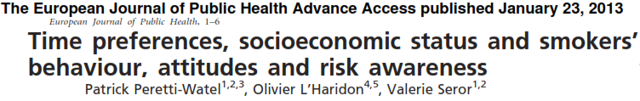
II.4. The social differentiation of smoking. (4/5)
Prevention as an intertemporal choice → time preferences.
Why are low-SES people more prone to smoke/less likely to quit?
Low SES
Among smokers: (logistic regressions)
+
-
-
Fear of smoking-related cancers
Interest toward prevention
Present-oriented
-
-
+
Recent smoking reduction
Recent quitting attempt
current smoking

Slide 33
II.4. The social differentiation of smoking. (4/5)
Prevention as an intertemporal choice → time preferences.
Why are low-SES people more prone to smoke/less likely to quit?
Low SES
Among smokers: (logistic regressions)
+
-
-
Fear of smoking-related cancers
Interest toward prevention
Present-oriented
-
-
+
Recent smoking reduction
Recent quitting attempt
current smoking
…because they are more present-oriented:
hardship shortens time horizon.

Slide 34
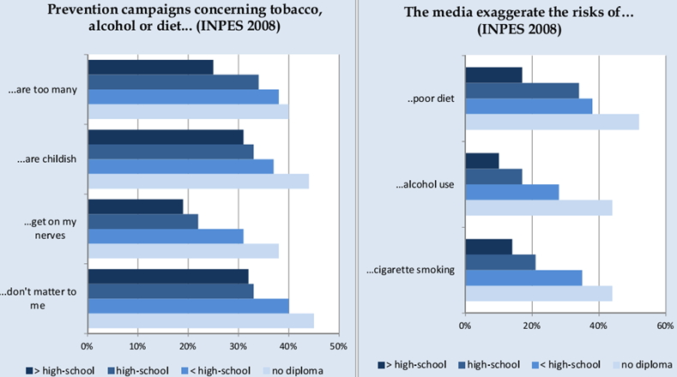
II.4. The social differentiation of smoking. (5/5)
Why are low-SES people more prone to smoke/less likely to quit?

Slide 35
II.4. The social differentiation of smoking. (5/5)
Why are low-SES people more prone to smoke/less likely to quit?
…because they are less likely to trust health authorities,
and more likely to endorse risk denial beliefs.

Slide 36
III. Why do HIV-infected people smoke?
III.1. Because of a low SES…
III.2. Motives, justifications & time horizon.
III.3. Motives to smoke and willing to quit.

Slide 37
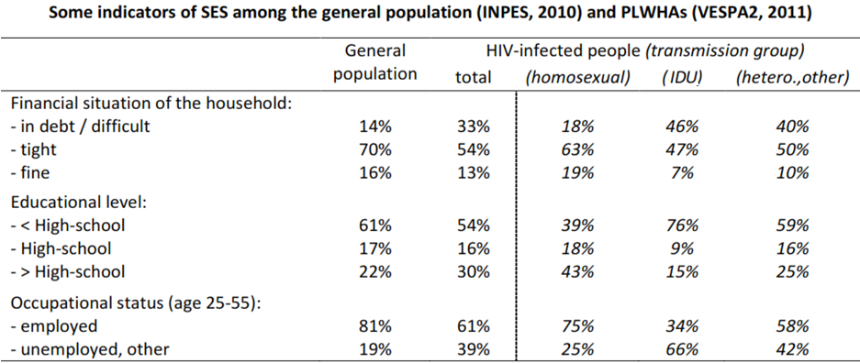
III.1. …because of a low SES (1/3)
The average SES is lower among PLWHAs,
with a great heterogeneity according to transmission group
→ Homosexuals >> hetero.,other >> IDUs

Slide 38
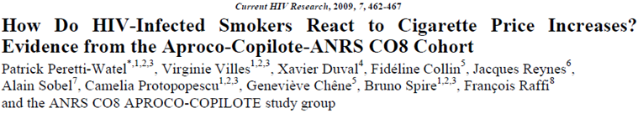
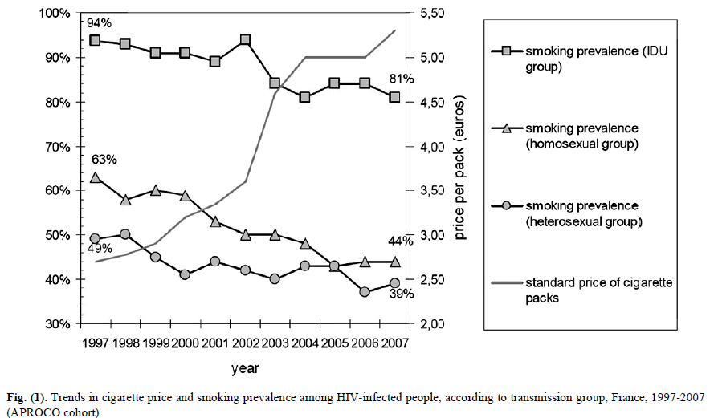
III.1. …because of a low SES (2/3)

Slide 39
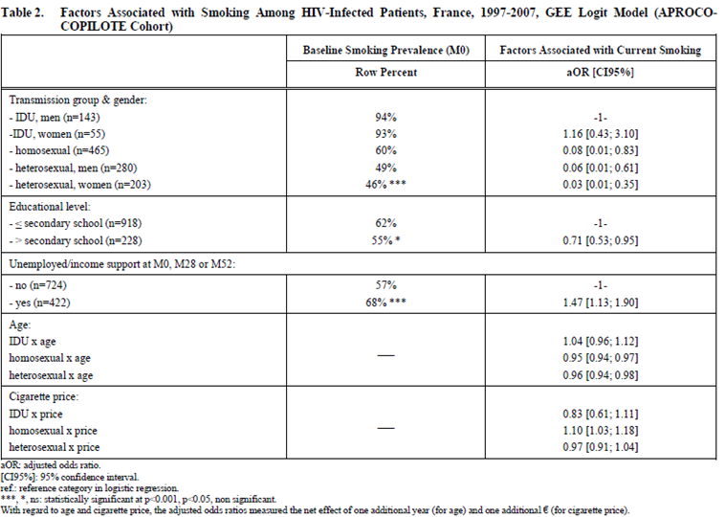

III.1. …because of a low SES (3/3)

Slide 40
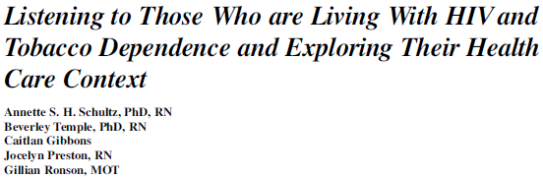

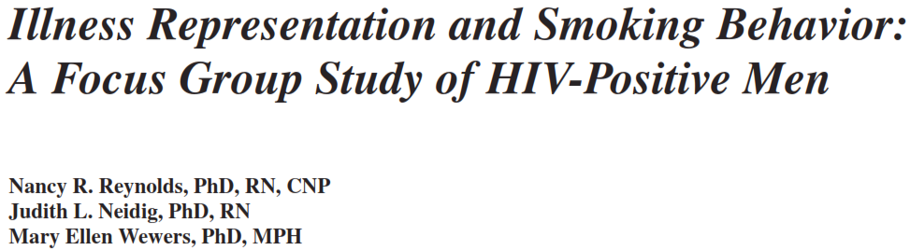
III.2. Motives, justifications & time horizon. (1/7)
Common and specific motives & justifications
Qualitative insight:
+quantitative
data...
→ Motives to smoke, disadvantages of smoking, obstacles to quitting...

Slide 41
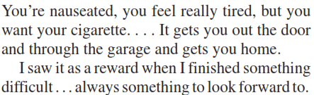
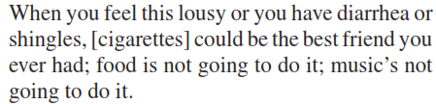
III.2. Motives, justifications & time horizon. (2/7)
Benefits of smoking
a means of easing social bonding;
A psychological incentive………...
a pleasurable activity providing
comfort, relief, distraction from unpleasant sensation………..
…including relief from illness- or treatment-related symptoms:
(some people think that smoking raises
T-cell counts and help fighting infection)
…or coping with the diagnosis:
mixing smoking with illicit drug use and drinking alcohol;
(// quantitative studies)
→ common and specific motives.

Slide 42
III.2. Motives, justifications & time horizon. (3/7)
A specific motive: stress induced by experience of stigma.
// ‘race-related’ stigma and smoking among African Americans, King G, Soc Sci Med 1997.

Slide 43
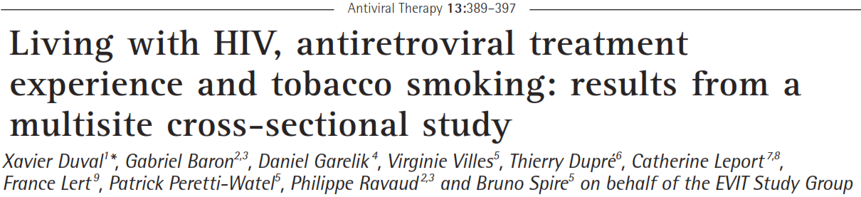
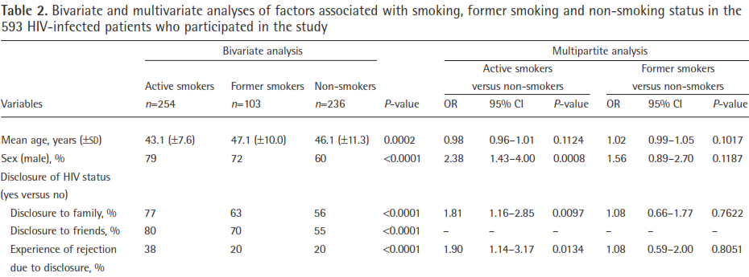
III.2. Motives, justifications & time horizon. (4/7)
A specific motive: stress induced by experience of stigma

Slide 44


III.2. Motives, justifications & time horizon. (5/7)
Disadvantages of smoking and risk denial/relativization
an expensive habit;
a source of disgust:
discounting health risk:
- risk denial beliefs:
- relativization & time horizon:
Obstacles to smoking cessation
reluctance to giving up a key coping mechanism;
concerns about the potential for weight gain;
relationships with care providers:

Slide 45
III.2. Motives, justifications & time horizon. (6/7)
Time horizon→present-orientation and smoking in VESPA2:
In multivariate analysis present-orientation remained a significant risk factor for current smoking (after adjustment on sociodemographic profile, transmission group…).

Slide 46
HIV-infected smokers’ motives and justifications:
-as other smokers, they frequently portray themselves as rational beings assessing the costs and benefits of smoking;
regarding other smokers, they also share the same motives (facilitating social interaction, stress relief) and justifications (compensatory measures: exercise…),
but some motives and risk denial beliefs are more specific to HIV (stress due to HIV, lack of confidence toward physicians, dealing with symptoms or side-effects of treatment, relativization because of HIV, shortened time-horizon due to HIV);
→ their priority is HIV now and they think that smoking helps them to cope with stress and to stay mentally positive now.
III.2. Motives, justifications & time horizon. (7/7)

Slide 47
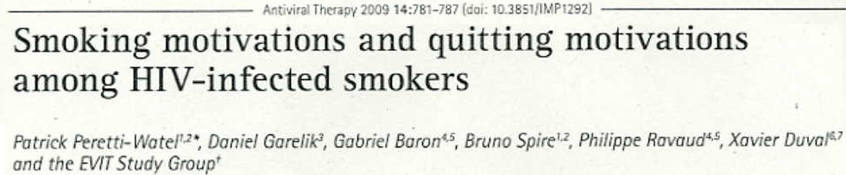
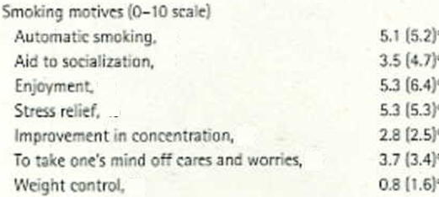
III.3. Motives to smoke and willing to quit (1/2)

Slide 48
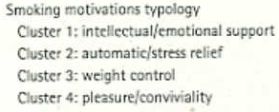
III.3. Motives to smoke and willing to quit (1/2)

Slide 49
III.3. Motives to smoke and willing to quit (1/2)

Slide 50
III.3. Motives to smoke and willing to quit (1/2)

Slide 51
III.3. Motives to smoke and willing to quit (1/2)

Slide 52
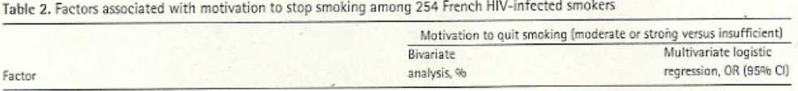
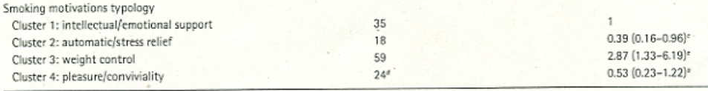
Motives to smoke and willing to quit:
- Intellectual/emotional support (22%).
Automatic/stress relief (22%): women, ≥20 cig./day; strong nicotine dependence, anxiety, recent opiate use, past experience of discrimination due to HIV…
Weight control (29%): age>50, depressive symptoms, fat accumulation due to treatment side-effects…
Pleasure/conviviality (27%): men, age<40, mild dependence.
III.3. Motives to smoke and willing to quit (2/2)

Slide 53
Conclusion.
Smoking is a social practice that involves a whole set of beliefs, attitudes and behaviours, embedded in social context.
Social differentiation of smoking and prevention efficacy, including among HIV-infected smokers.
HIV-infected smokers have both common and specific motives & justifications.
To make them quit, it is necessary to convince them that it’s worth it.

Slide 54
Acknowledgements
Participants to surveys Vespa & Vespa2
Methodological support: Yann Le Strat (InVS, Saint-Maurice), Lise Cuzin (Hôpital Purpan, Toulouse), Laurence Meyer (Cesp, Inserm, Le Kremlin Bicêtre); Daniela RojasCastro (Aides, Pantin) et Hugues Fischer (Act-Up Paris) –Data collection: Ipsos, Clinsearch
VESPA research group : France Lert , Bruno Spire (co-PI), Patrizia Carrieri, Rosemary Dray-Spira, Christine Hamelin, Nicolas Lorente, Marie Préau, Marie Suzan-Monti, Marion Mora, Gwenaelle Maradan.
Investigators/ participating centers: Aix-en-Provence, CH Pays d'Aix (T. Allègre, P. Mours, J.M. Riou, M. Sordage) ; Angers, CHU Hôtel-Dieu (J.M. Chennebault, P. Fialaire, V.Rabier) ; Annemasse, CH Alpes-Léman (M. Froidure, D.Huguet, D. Leduc) ; Avignon, Hôpital Henri Duffaut (G. Pichancourt, A. Wajsbrot) ; Besançon, Hôpital Saint-Jacques (C. Bourdeaux, A. Foltzer, B. Hoen, L. Hustache-Mathieu) ; Bobigny, Hôpital Avicenne (S. Abgrall,R. Barruet, O. Bouchaud, A. Chabrol, S. Mattioni, F. Mechai) ; Bondy, Hôpital Jean Verdier (V. Jeantils) ;Bordeaux, Hôpital Saint-André (N. Bernard, F. Bonnet,M. Hessamfar, D. Lacoste, D. Malvy, P. Mercié, P.Morlat, F. Paccalin, M.C. Pertusa, T. Pistone, M.C. Receveur, M.A. Vandenhende) ; Boulogne-Billancourt,Hôpital Ambroise Paré (C. Dupont, A. Freire Maresca, J. Leporrier, E. Rouveix) ; Caen, Hôpital Clémenceau (S. Dargere, A. de la Blanchardière, A. Martin, V. Noyon, R. Verdon) ; CH de Chambéry (O.Rogeaux) ; Clermont-Ferrand, CHU Gabriel Montpied (J. Beytout, F.Gourdon, H. Laurichesse) ; Colombes,Hôpital Louis-Mourier (F. Meier, E. Mortier, A.M. Simonpoli) ; Creil, CH Laennec (F. Cordier) ; Créteil, CHIC(I. Delacroix, V. Garrait, B. Elharrar), Hôpital Henri Mondor (S. Dominguez, A.S. Lascaux, J.D. Lelièvre, Y.Levy, G. Melica) ; Dijon, Hôpital du Bocage (M. Buisson, L. Piroth, A. Waldner) ; Eaubonne, Hôpital SimoneVeil (N. Gruat, A. Leprêtre) ; Garches, Hôpital Raymond-Poincaré (P. de Truchis, D. Le Du, J.Cl. Melchior) ;CH de Gonesse (R. Sehouane, D. Troisvallets) ; CHU de Grenoble (M. Blanc, I. Boccon-Gibod, A.Bosseray, J.P. Brion, F. Durand, P. Leclercq, F. Marion, P. Pavese) ; La Rochelle, Hôpital Saint-Louis (E.Brottier-Mancini, L. Faba, M. Roncato-Saberan) ; La Roche-sur-Yon, CHD Les Oudairies (O. Bollengier-Stragier, J.L. Esnault, S. Leautez-Nainville, P. Perré) ; CH de Lagny Marne-la-Vallée (E. Froguel, M. Nguessan, P. Simon) ; Le Chesnay, CH de Versailles (P. Colardelle, J. Doll, C. Godin-Collet, S. Roussin-Bretagne) ; Le Kremlin-Bicêtre, Hôpital de Bicêtre (J.F. Delfraissy, M. Duracinsky, C. Goujard, D. Peretti, Y.Quertainmont) ; CH du Mans (J. Marionneau) ; Lens, CH Dr. Schaffner (E. Aissi, N. Van Grunderbeeck) ;Limoges, CHU Dupuytren (E. Denes, S. Ducroix-Roubertou, C. Genet, P. Weinbreck) ; Lyon, Hôpital de la Croix-Rousse (C. Augustin-Normand, A. Boibieux, L. Cotte, T. Ferry, J. Koffi, P. Miailhes, T. Perpoint, D.Peyramond, I. Schlienger) ; Hôpital Édouard-Herriot (J.M. Brunel, E. Carbonnel, P. Chiarello, J.M. Livrozet, D. Makhloufi) ; Marseille, Hôpital de la Conception (C. Dhiver, H. Husson, A. Madrid, I. Ravaux, M.L. de Severac, M. Thierry Mieg, C. Tomei), Hôpital Nord (S. Hakoun, J. Moreau, S. Mokhtari, M.J. Soavi), Hôpital Sainte Marguerite (O. Faucher, A. Ménard, M. Orticoni, I. Poizot-Martin, M.J. Soavi) ; Montpellier, Hôpital Gui de Chauliac (N. Atoui, V. Baillat, V. Faucherre, C. Favier, J.M. Jacquet, V. Le Moing, A. Makinson, R. Mansouri, C. Merle) ; Montivilliers, Hôpital Jacques Monod (N. Elforzli) ; Nantes, Hôtel-Dieu (C. Allavena, O. Aubry, M. Besnier, E. Billaud, B. Bonnet, S. Bouchez, D. Boutoille, C. Brunet, N. Feuillebois, M. Lefebvre, P. Morineau-Le Houssine, O. Mounoury, P. Point, F. Raffi, V. Reliquet, J.P. Talarmin) ; Nice, Hôpital l'Archet (C. Ceppi, E. Cua, P. Dellamonica, F. De Salvador-Guillouet, J. Durant, S. Ferrando, V. Mondain-Miton, I. Perbost, S. Pillet, B. Prouvost-Keller, C. Pradier, P. Pugliese, V. Rahelinirina, P.M. Roger,E. Rosenthal, F. Sanderson) ; Orléans, Hôpital de La Source (L. Hocqueloux, M. Niang, T. Prazuck), Hôpital Porte Madeleine (P. Arsac, M.F. Barrault-Anstett) ; Paris , Hôpital Bichat - Claude-Bernard (M. Ahouanto, E. Bouvet, G. Castanedo, C. Charlois-Ou, A. Dia Kotuba, Z. Eid-Antoun, C. Jestin, K. Jidar, V.Joly, M.A. Khuong-Josses, N. Landgraf, R. Landman, S. Lariven, A. Leprêtre, F. L'hériteau, M. Machado, S.Matheron, F. Michard, G. Morau, G. Pahlavan, B.C. Phung, M.H. Prévot, C. Rioux, P. Yéni), Hôpital Cochin-Tarnier (F. Bani-Sadr, A. Calboreanu, E. Chakvetadze, D. Salmon, B. Silbermann), Hôpital européen Georges-Pompidou (D. Batisse, M. Beumont, M. Buisson, P. Castiel, J. Derouineau, M.Eliaszewicz, G. Gonzalez, D. Jayle, M. Karmochkine, P. Kousignian, J. Pavie, I. Pierre, L. Weiss), Hôpital Lariboisière (E. Badsi, M. Bendenoun, J. Cervoni, M. Diemer, A. Durel, A. Rami, P. Sellier), Hôpital Pitié-Salpêtrière (H. Ait-Mohand, N. Amirat, M. Bonmarchand, F.Bourdillon, G. Breton, F. Caby, J.P. Grivois, C.Katlama, M. Kirstetter, L. Paris, F. Pichon, L. Roudière, L. Schneider, M.C. Samba, S. Seang, A.Simon, H.Stitou, R. Tubiana, M.A. Valantin), Hôpital Saint-Antoine (D. Bollens, J. Bottero, E. Bui, P. Campa, L. Fonquernie, S. Fournier, P.M. Girard, A. Goetschel, H.F. Guyon, K. Lacombe, F. Lallemand, B. Lefebvre,J.L. Maynard, M.C. Meyohas, Z. Ouazene, J. Pacanowski, O. Picard, G. Raguin, P. Roussard, M. Tourneur, J. Tredup ,N.Valin) Hôpital Saint-Louis (S. Balkan, F. Clavel, N. Colin de Verdière, N. De Castro, V. deLastours, S. Ferret, S. Gallien, V. Garrait, L. Gérard, J. Goguel, M. Lafaurie, C. Lascoux-Combe, J.M.Molina, E. Oksenhendler, J. Pavie, C.Pintado, D. Ponscarme, W. Rozenbaum, A. Scemla), Hôpital Tenon(P. Bonnard, L. Lassel, M.G. Lebrette, T. Lyavanc, P. Mariot, R. Missonnier, M. Ohayon, G. Pialoux, M.P.Treilhou, J.P. Vincensini) ; Hôtel-Dieu (J. Gilquin, B. Hadacek, L. Nait-Ighil, T.H. Nguyen, C. Pintado, A.Sobel, J.P. Viard, O. Zak Dit Zbar) ; Perpignan, Hôpital Saint-Jean (H. Aumaître, A. Eden, M. Ferreyra, F. Lopez, M. Medus, S. Neuville, M. Saada) ; Pontoise, CH René Dubos (L. Blum) ; Quimper, Hôpital Laennec (P. Perfezou) ; Rennes, Hôpital de Pontchaillou (C. Arvieux, J.M. Chapplain, M. Revest, F. Souala, P. Tattevin) ; Rouen, Hôpital Charles-Nicolle (S. Bord, F. Borsa-Lebas, F. Caron, C. Chapuzet, Y. Debab, I.Gueit, M. Etienne, C. Fartoukh, K. Feltgen, C. Joly, S. Robaday-Voisin, P. Suel) ; Saint-Denis, CH Delafontaine (M.A. Khuong, J. Krausse, M. Poupard, G. Tran Van) ; Saint-Étienne, CHU Nord (C. Cazorla, F. Daoud, P. Fascia, A. Frésard, C. Guglielminotti, F. Lucht) ; Strasbourg, Nouvel hôpital civil (C. Bernard-Henry, C. Cheneau, J.M. Lang, E. de Mautort, M. Partisani, M. Priester, D. Rey) ; Suresnes, Hôpital Foch (C. Majerholc, D. Zucman) ; Toulon, CHI Chalucet (A. Assi, A. Lafeuillade), Hôpital Sainte-Anne (J.P. de Jaureguiberry, O. Gisserot) ; Toulouse, Hôpital de La Grave (C. Aquilina, F. Prevoteau du Clary), HôpitalPurpan (M. Alvarez, M. Chauveau, L. Cuzin, P. Delobel, D. Garipuy, E. Labau, B. Marchou, P. Massip, M. Mularczyk, M. Obadia) ; Tourcoing, CH Gustave Dron (F. Ajana, C. Allienne, V. Baclet, X. de la Tribonnière, T. Huleux, H. Melliez, A. Meybeck, B. Riff, M. Valette, N. Viget) ; Tours, CHRU Bretonneau (F. Bastides, L.Bernard, G. Gras, P. Guadagnin) ; Vandoeuvre-lès-Nancy, CHU Brabois (T. May, C. Rabaud) ; Vannes, CH Bretagne Atlantique (A. Dos Santos, Y. Poinsignon) ; Villejuif, Hôpital Paul-Brousse, (O. Derradji, L. Escaut,E. Teicher, D. Vittecoq) ; CHI de Villeneuve-Saint-Georges, (J. Bantsima, P. Caraux-Paz, O. Patey).
Funding: ANRS

