Slide 1

Update on risk factors, detection, and management of neurocognitive impairment in HIV-infected persons
Scott Letendre, M.D.
Professor of Medicine and Psychiatry
University of California, San Diego

Slide 2
Disclosures
Funds for investigator-initiated research were paid to University of California, San Diego:
Abbvie
Gilead Sciences
Merck & Co., Inc.
ViiV Healthcare
Honoraria for advisory boards or lectures were paid to Dr. Letendre:
Abbvie
Cipla
Janssen
Merck & Co., Inc.
ViiV Healthcare

Slide 3
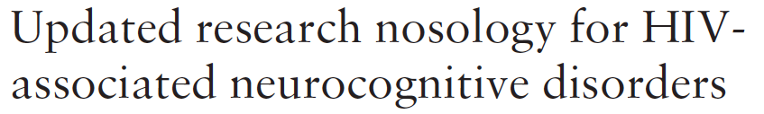
Definition of HAND
 | Acquired Impairment in ≥ 2 Cognitive Abilities | Interferes with Daily Functioning | No Cause Prior to HIV | No Current Strongly Confounding Condition
Asymptomatic Neurocognitive Impairment (ANI) | ✔ | No | ✔ | ✔
Mild Neurocognitive Disorder (MND) | ✔ | Mild | ✔ | ✔
HIV-Associated Dementia (HAD) | Marked | Marked | ✔ | ✔
Antinori et al, Neurology 2007, 69: 1789-99

Slide 4
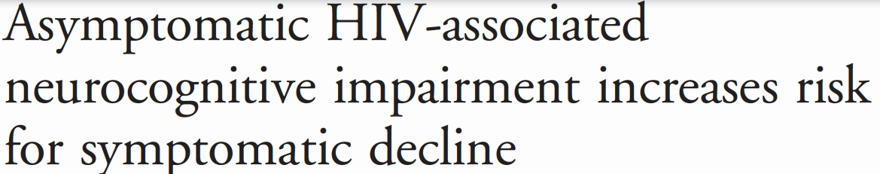
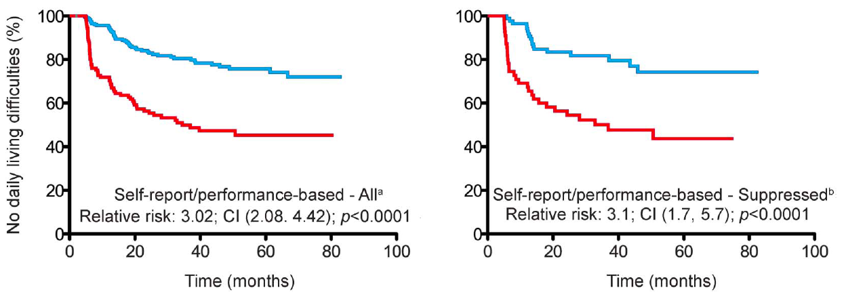
347 adults who were either unimpaired (n = 226) or had ANI (n = 121)
Assessed every 6 months with median follow-up of 45.2 months
Symptomatic decline was based on self-report or objective, performance-based problems in everyday functioning
Current CD4 and depression were significant time-dependent covariates
Grant et al, Neurology 2014;82:1–8

Slide 5
More Subjects Meet Criteria for Symptomatic HAND if the Requirement for Attribution of Problems to a Cognitive Disorder is Eliminated
With Attribution*
Without Attribution*
*Attribution regarding physical vs. cognitive causes
Diagnoses made by combination of self-report and performance based measures
Heaton et al, Unpublished CHARTER Data

Slide 6
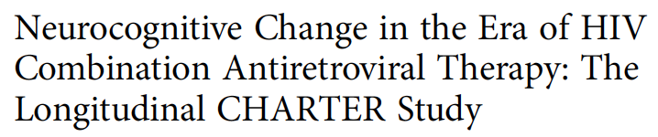
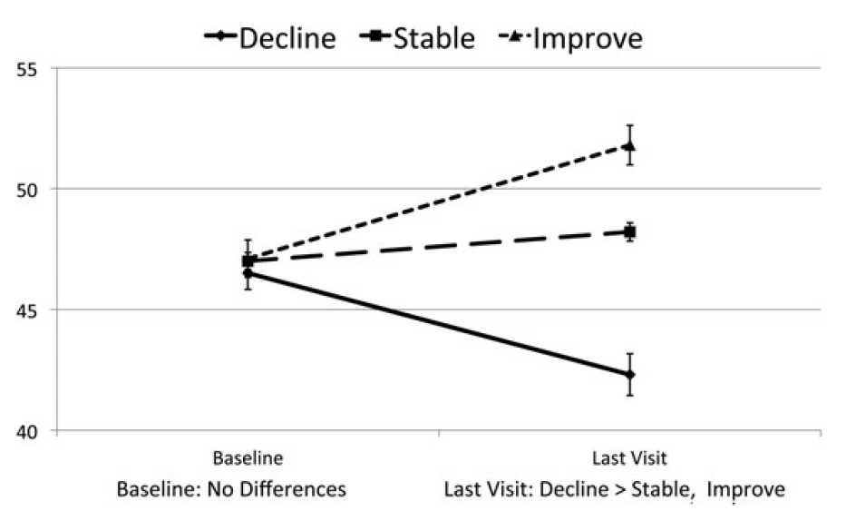
Analyzed incidence and predictors of neurocognitive change over mean 35 months in 436 HIV+ adults who were assessed every 6 months
16.5% Improved
60.8% Stable
22.7% Declined
Heaton et al, Clinical Infectious Diseases 2015; 60(3):473–80

Slide 7
 | Decline
 | Risk | RR
Sex | Female | 1.76*
Ethnicity¹ | Hispanic | 2.35**
ART Use¹ | Off ART | 1.91**
Current CD4 Count | Lower† | 1.14**
HIV RNA in Plasma | Higher† | 1.26**
Serum Albumin¹ | Lower† | 2.36***
Hematocrit¹ | Lower† | 1.10***
Neuropsychiatric Comorbidities¹ | Severe | 2.47**
Lifetime Methamphetamine Diagnosis¹ | Present | 1.81*
Beck Depression Inventory¹ | Higher† | 1.03
 | Improvement
 | Risk | RR
Sex | - | -
Education | Higher† | 1.10
Est. IQ Before HIV¹ | Higher† | 1.02*
HIV RNA in CSF | Lower† | 1.47*
HIV RNA in Plasma | Lower† | 1.27*
Serum Total Protein¹ | Lower† | 1.96***
Hematocrit | Higher† | 1.06*
Serum Hepatic AST¹ | Lower† | 1.01*
Lifetime Substance Use Diagnosis | Absent | 1.63
Lifetime Major Depression Disorder¹ | Absent | 1.63*
*p < 0.05, **p < 0.01, ***p < 0.0001
†CD4: per 100 cells; HIV RNA: per 1 log₁₀ c/mL; Albumin, Hematocrit, Total Protein, AST: Per 1 “unit”; Beck
Depression: Per 1 unit; IQ: Per 1 unit; Education: Per year; Hepatic AST: Per 1 mg/dL; Total Protein: Per 1 g/dL
¹Included in the final multivarable model (in red)

Slide 8
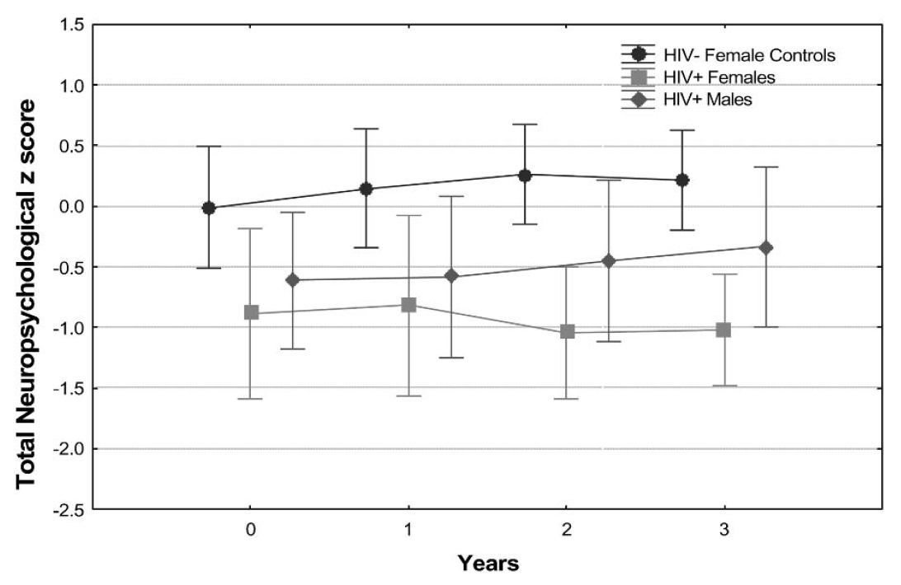
As the US Incidence of HIV in Women Rose, Early Findings Were Mixed
An early pilot study published of HIV+ women identified that women performed worse than men on tests of neurocognitive functioning
A subsequent larger, prospective study found no difference
Robertson K, et al. J Neuro-AIDS. 1996;1: 166;
Robertson K, et al, J Acquir Immune Defic Syndr 2004;36:817–822

Slide 9
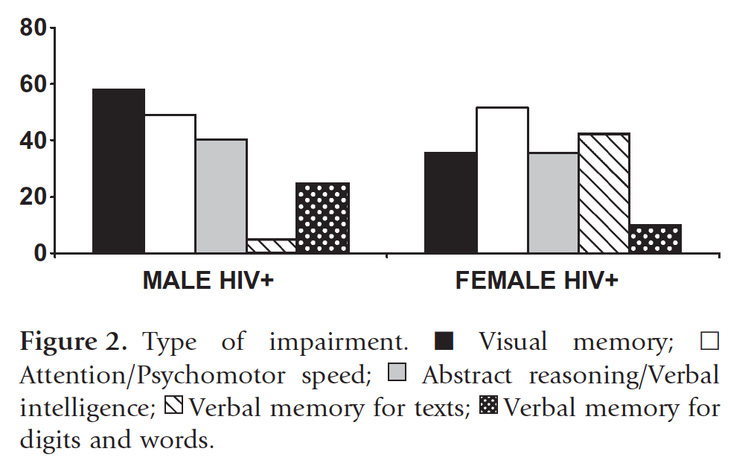
Pattern of Impaired Cognitive Abilities May Differ Between Women and Men
122 adults who differed by HIV serostatus and sex
HIV was associated with impairment to a similar extent in men (52%) and women (55%) but the pattern of impairment differed
Impairment (%)
Faílde-Garrido JM et al,
Psych Clin Neurosci 2008; 62: 494

Slide 10
Interaction of Cognitive Functioning and Mood Symptoms
708 HIV+ and 278 HIV- women from the WIHS
HIV, but not menopausal stage, was associated with worse performance on all cognitive measures
 | Verbal Learning | Memory | Executive Function
HIV Serostatus | p < 0.01 | p < 0.05 | p < 0.05
Depressive Symptoms | p < 0.05 | p < 0.05 | p < 0.05
Anxiety Symptoms | p < 0.05 | p < 0.01 | -
Sleep Disturbances | - | - | -
HIV x Anxiety Interaction* | p < 0.001 | - | -
*Anxiety was associated with worse learning only among HIV+ women
Rubin et al, Menopause 2014. 21(9): 997-1006
Also see: Giesbrecht et al, PLoS One 2014. 9(3): e89556

Slide 11

Challenges to the Implementation of the Current Approach to HAND Diagnosis
Screening instruments are not consistently sensitive between sites
We do not routinely perform comprehensive neurocognitive testing in clinic
Many of our patients are unemployed or have below average socioeconomic status, complicating assessment of daily functioning
Confidently deciding that a condition confounds attribution of the cause of impairment to HIV can be difficult

Slide 12
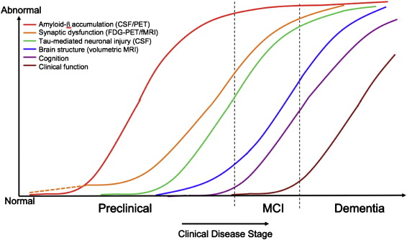
Soluble Biomarkers Identify a Preclinical Stage in Alzheimer’s
Sperling et al, Alzheimer’s & Dementia 7 (2011) 280–292

Slide 13
ANI and MND are Associated with Higher Neopterin but not NFL
Cross-sectional analysis of 150 HIV+ subjects taking suppressive ART without significant neuropsychiatric confounds
Subjects were classified as NP-normal (NPN, n=79) or NP-impaired (ANI, n = 38; MND, n=33)
p < 0.01
Edén et al, CROI 2014, Abstract 490

Slide 14
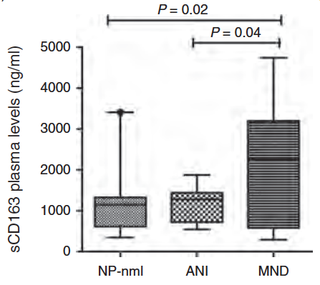
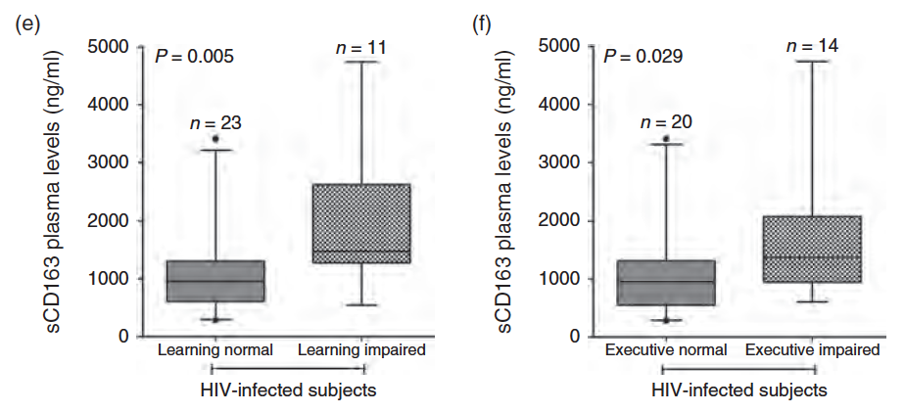
Higher Soluble CD163 in Plasma in MND but not ANI
Burdo et al, AIDS 2013, 27:1387–1395
Notes:
Here we evaluated whether neurocognitive disorders in HIV-infected
individuals on effective antiretroviral therapy (ART) are associated with persistent
monocyte activation as indexed by levels of soluble CD163 (sCD163), shed by
monocyte/macrophages.
Design: Chronically, HIV-infected individuals were examined at two consecutive visits
median [interquartile range (IQR)] 16 (7–32) months apart. All patients were on ART
and durably virologically suppressed (plasma HIV RNA <50 copies/ml) at all visits.
Thirty-four age-matched HIV-seronegative patients were used as controls.
Methods: A global deficit score (GDS) was calculated based on comprehensive
neuropsychological assessment according to standard methods. Neuropsychological
and medical data were used to assign neurocognitive status according to published
guidelines for HIV-associated neurocognitive disorders (HAND) as follows: neuropsychologically
normal (NP-nml), asymptomatic neuropsychological impairment (ANI)
and minor neurocognitive disorder (MND). sCD163 in plasma and cerebrospinal fluid
was measured using ELISA.
Results: GDS-impaired patients had higher plasma sCD163 than those who were not
impaired [median (IQR) 1401 ng/ml (1057–2258) versus 955 ng/ml (586–1313);
Wilcoxon P1/40.028]. Patients with MND (N1/46) had significantly higher plasma
sCD163 than ANI (P1/40.04) or NP-nml (P1/40.02). Whereas plasma sCD163 levels
dropped in patients who were stably GDS-unimpaired after the first visit (P<0.032),
levels remained elevated in those who remained GDS-impaired (P1/40.50).
Interpretation: These findings are consistent with persistent monocyte/macrophage
activation in neurophysiologically impaired HIV-infected individuals despite virally
suppressive ART. Overall, these observations underscore the significance of monocyte/
macrophage immune responses in HIV, persistent monocyte activation in HAND and
the value of sCD163, as a plasma marker of neurocognitive impairment

Slide 15
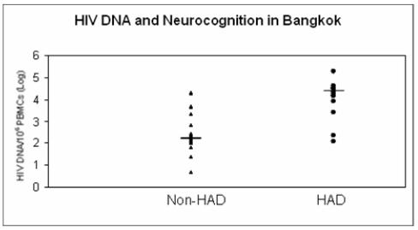
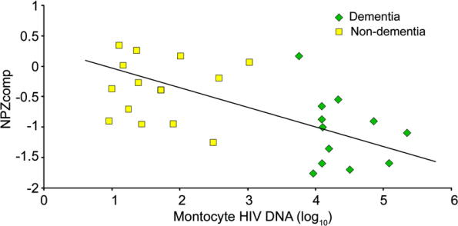
Higher HIV DNA Content is Associated with Worse Neurocognitive Performance
< 40 yo
Shiramizu et al, Int J Med Sci 2006, 6;4(1):13-8
> 50 yo
Oliveira et al, CROI 2015, Abstract 491
Valcour V et al, Neurology, 2009. 72(11):992-8

Slide 16
Possible Biological Classification of HAND
 | Higher HIV DNA | Higher sCD163 | Higher Neopterin | Higher Neurofilament Light | Alternative Diagnosis on Imaging
 | Blood | Blood | CSF | CSF | -
Asymptomatic Neurocognitive Impairment (ANI) | ✔ | No | ✔ | No | No
Mild Neurocognitive Disorder (MND) | ✔ | ✔ | ✔ | No | No
HIV-Associated Dementia (HAD) | ✔✔ | ✔ | ✔✔ | ✔ | No
Additional challenges:
Clinical standardization of assays
Identification of clinically relevant cutpoints

Slide 17
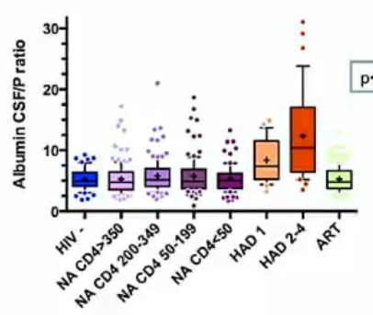
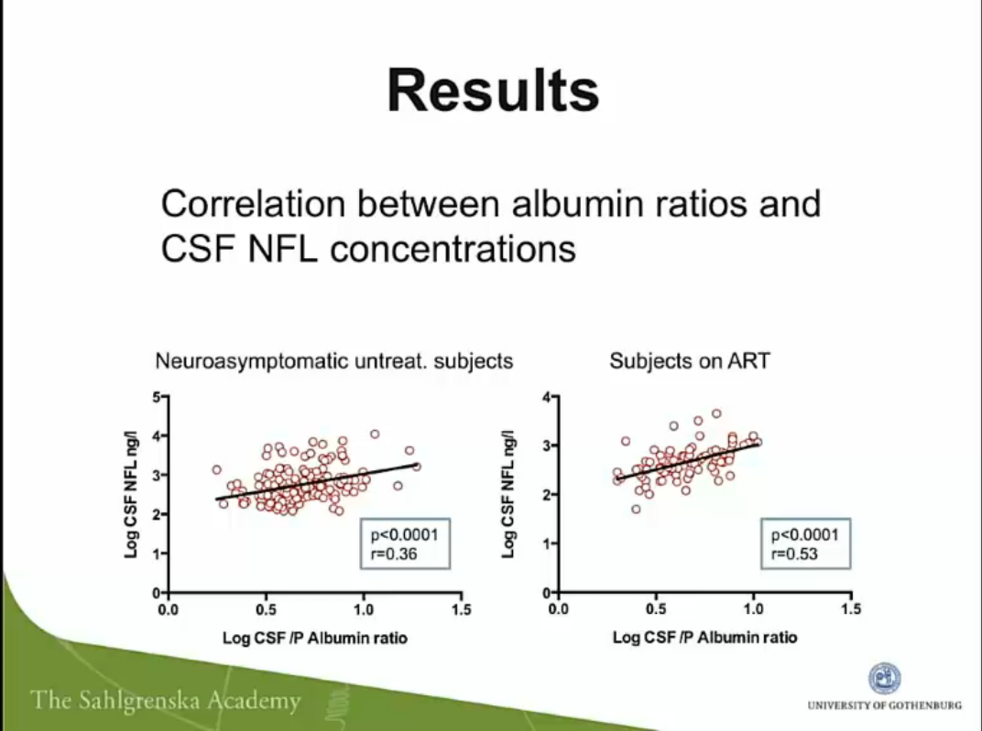
CSF/Plasma Albumin Ratio is Elevated in HAND
Neuroasymptomatic, off ART
p < 0.001
On ART
Anesten et al, CROI 2015. Abstract 59

Slide 18
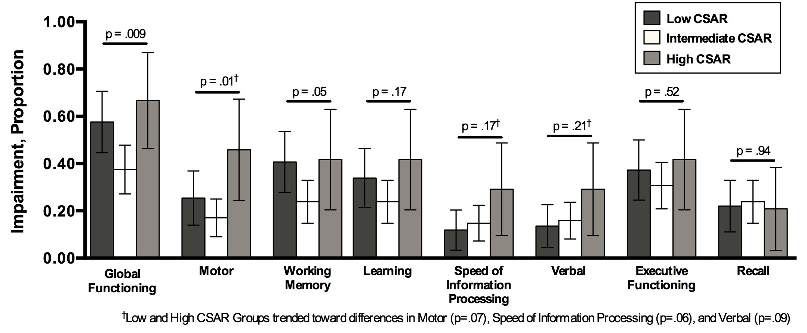
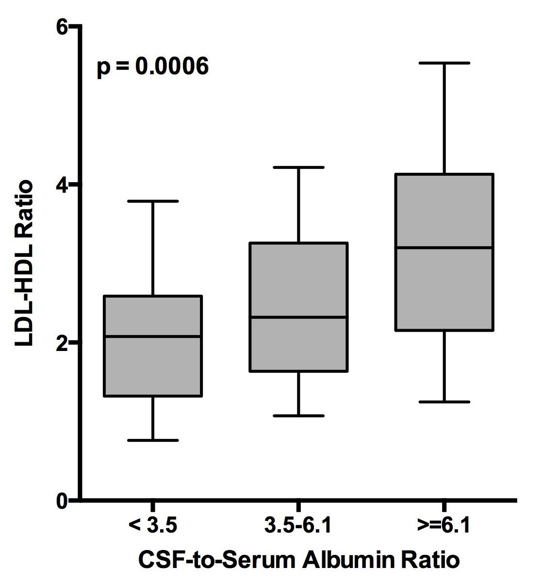
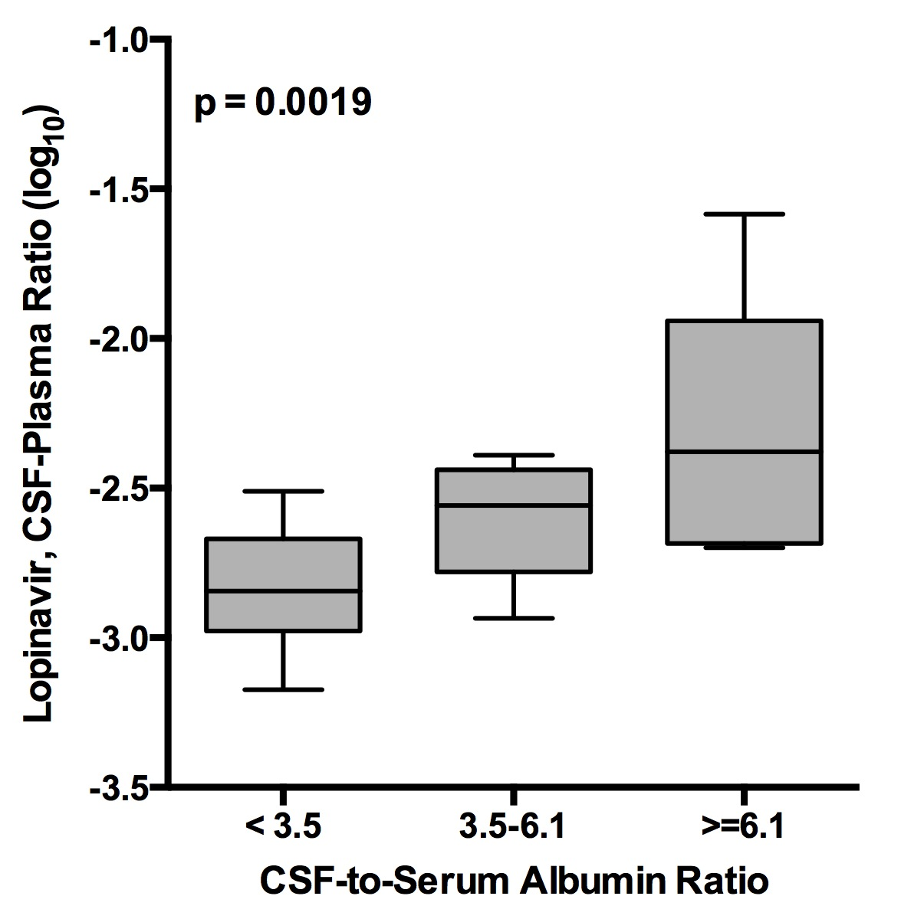
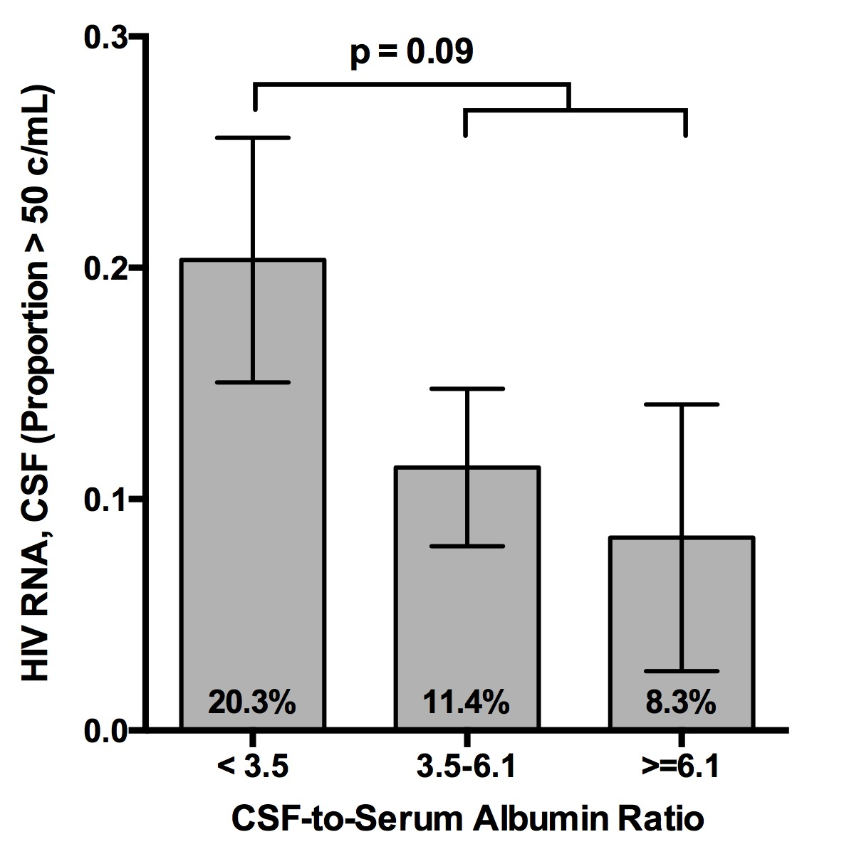
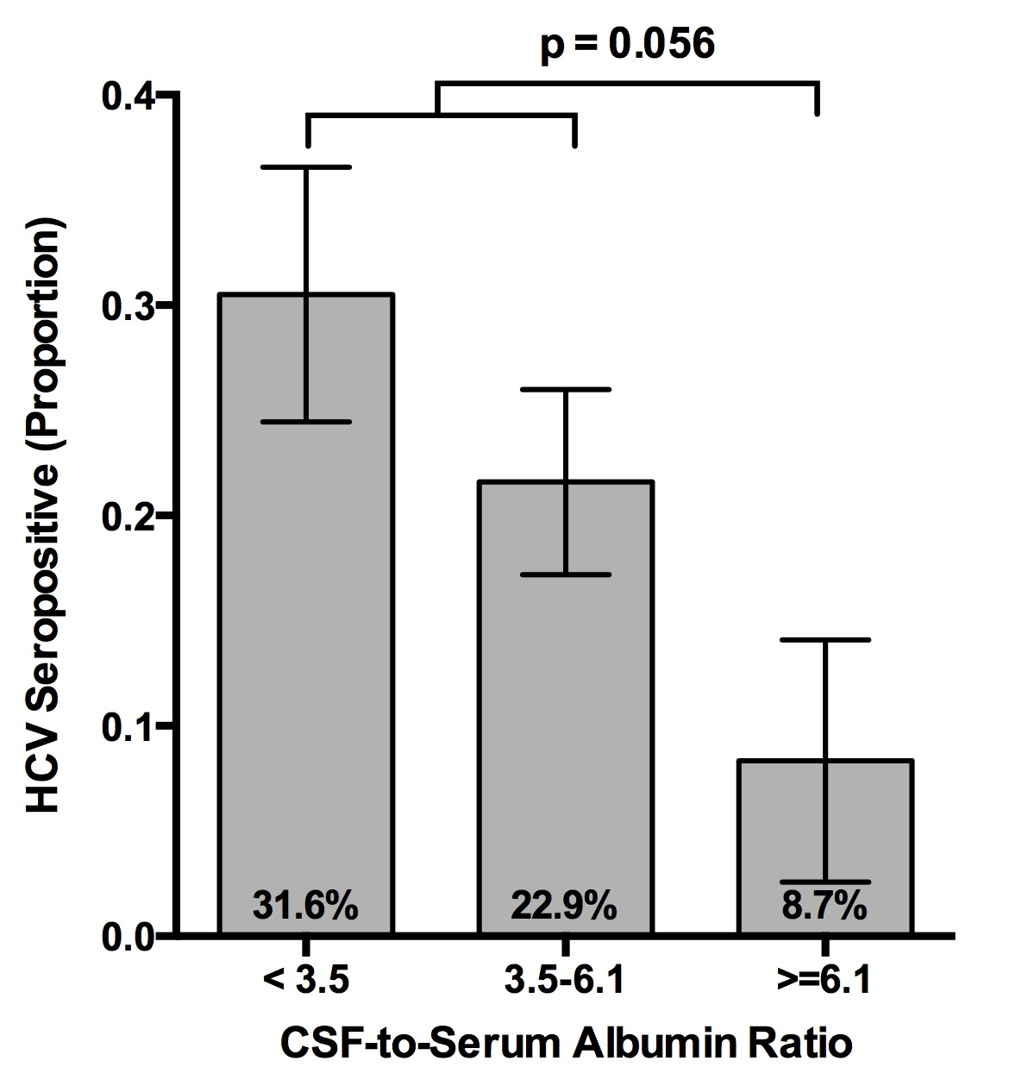
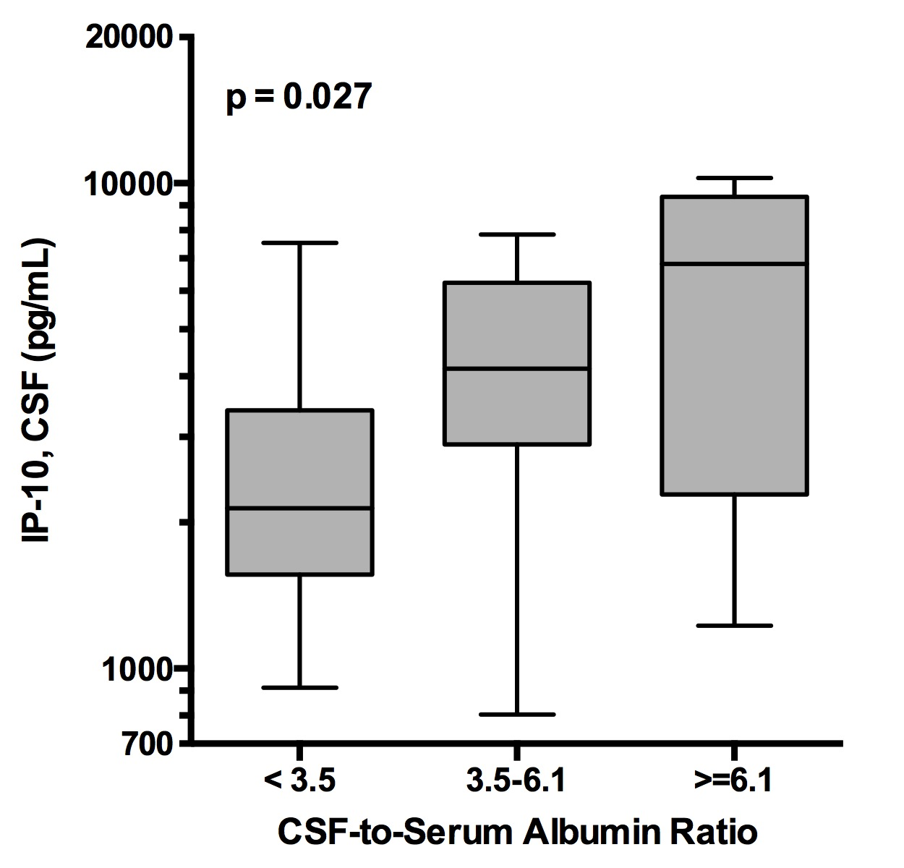
BBB Permeability During ART May Define Different HAND Phenotypes
CHARTER Data, Manuscript in Preparation

Slide 19
Biomarkers of HAND May Differ in Younger and Older HIV+ Adults
Similar in older and younger adults
HIV RNA (SCA)
Neurofilament light
sCD163
Neopterin
D-dimer, hsCRP
Stronger in older adults
HIV DNA
Telomere length and other aging biomarkers
IL-6, MCP-1, sCD40L
Amyloid β1-42, p-Tau

Slide 20
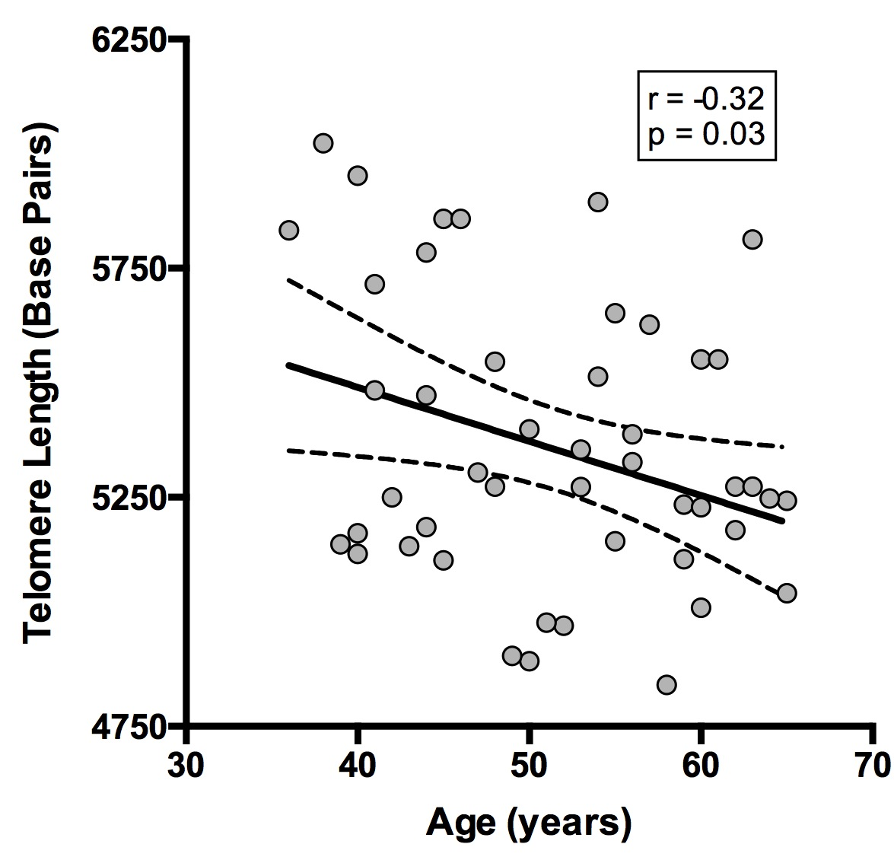
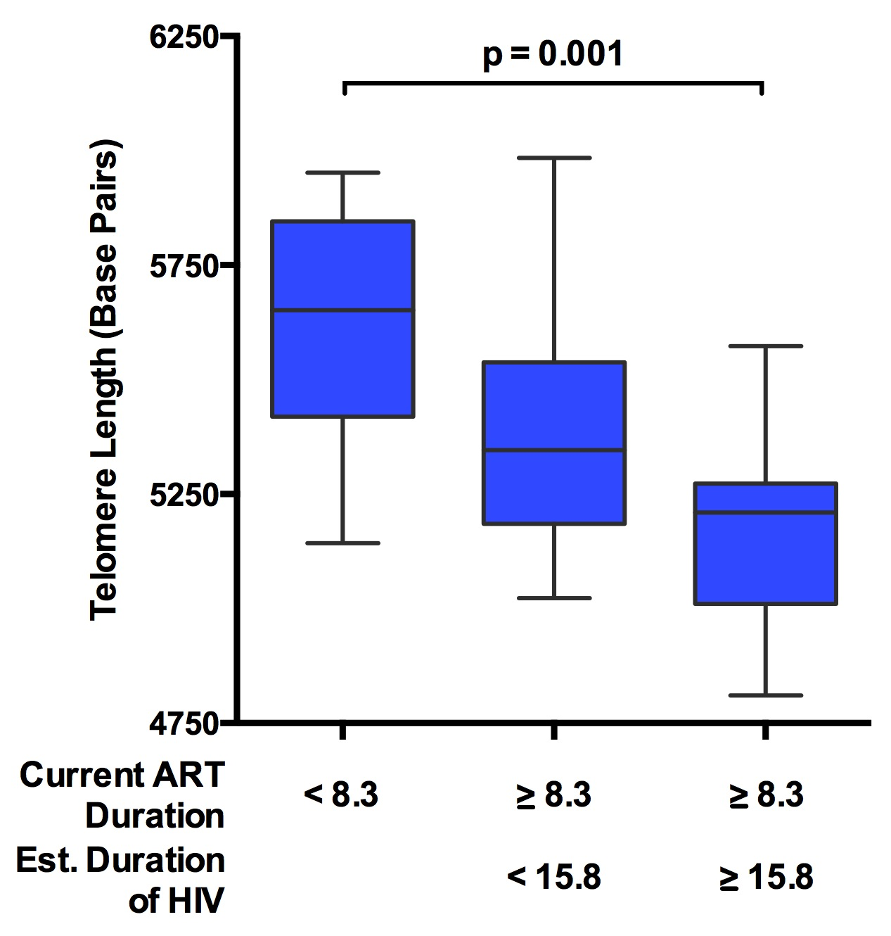
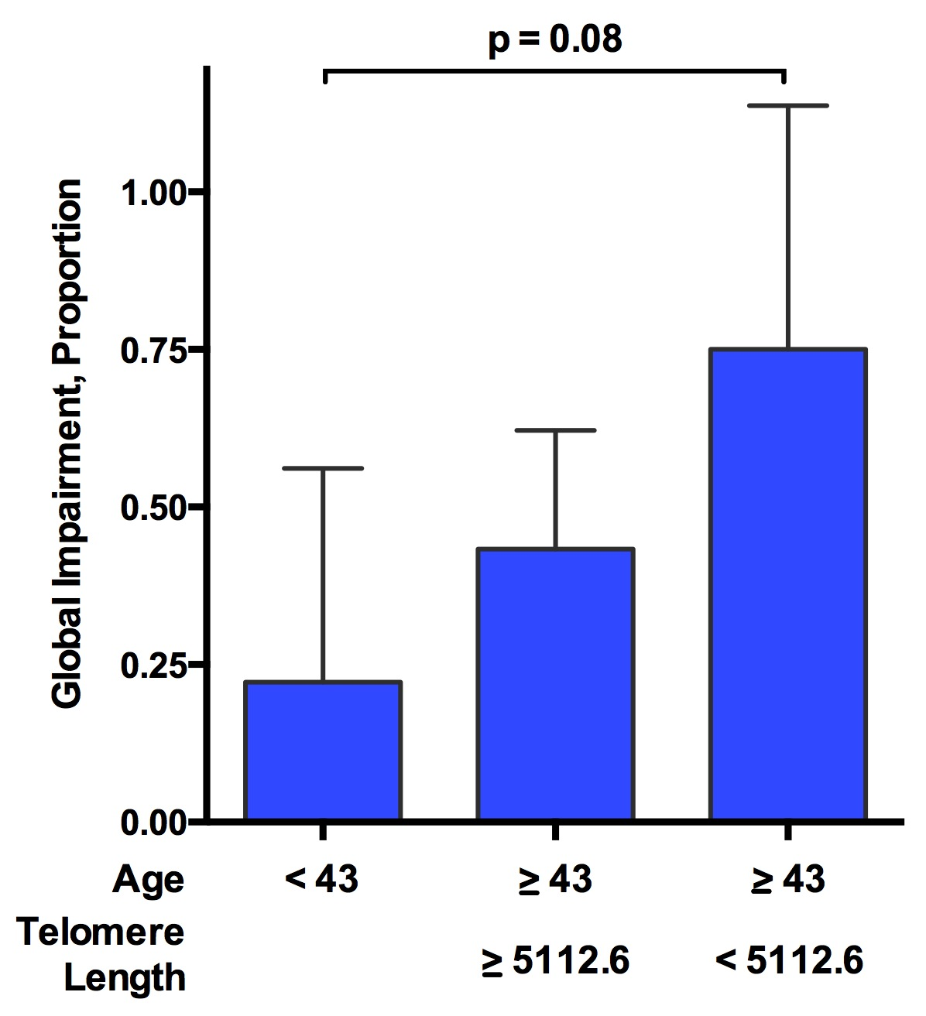
Correlates of Shorter Telomere Length
 | Risk | Effect size | P value | n
Sex | Male | d = 1.6 | 0.005 | 48
Ethnicity | White/Other | d = 1.0 | 0.001 | 48
Age | Older | r = -0.32 | 0.03 | 48
Est. Duration of HIV | Longer | r = -0.31 | 0.06 | 38
Duration of ART | Longer | r = -0.27 | 0.08 | 44
Plasma HIV RNA | > 50 c/mL | d = 1.0 | 0.07 | 34
Total Cholesterol | Lower | r = 0.33 | 0.03 | 43
Global Deficit Score |  | r = 0.04 | 0.80 | 47
GDS Impairment |  | X² = 0.09 | 0.76 | 47
Unpublished UCSD Data
Copyright S. Letendre 2015

Slide 21
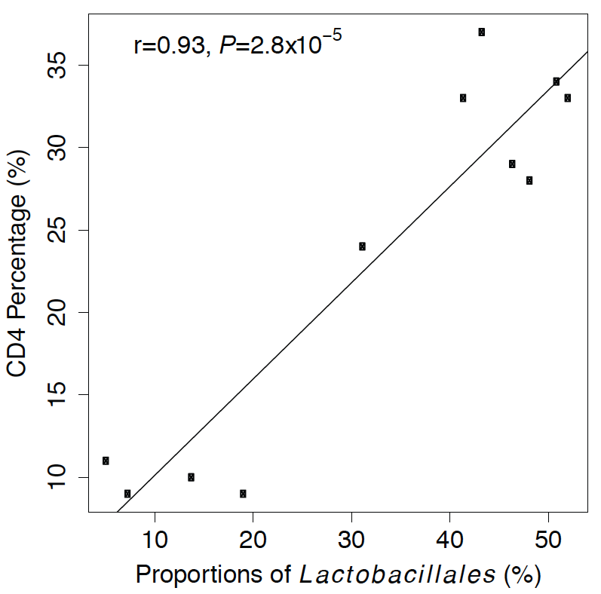
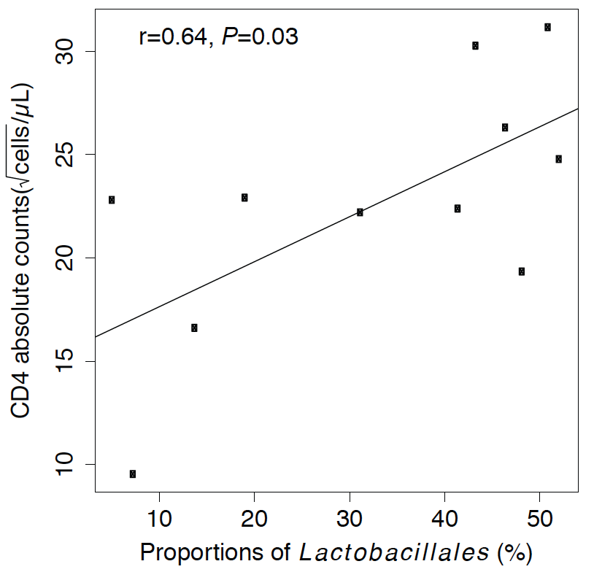
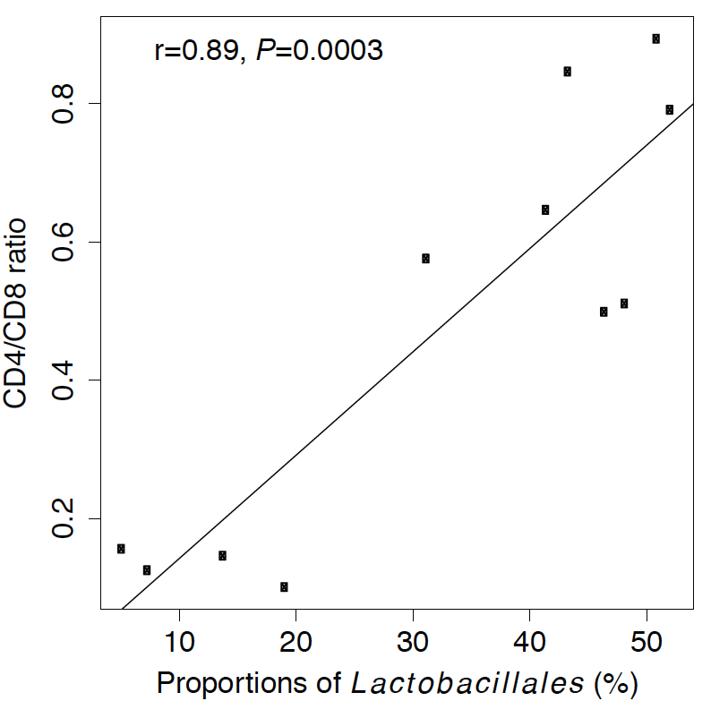
Higher Lactobacillales proportion in gut microbiome is associated with higher CD4 Count and CD4/CD8 ratio
Pérez Santiago et al, AIDS. 2013; 27(12):1921-31

Slide 22
Gut Microbiome Clustered by Presence or Absence of Neurocognitive Impairment
Before ART
After ART
Pérez Santiago et al, International Symposium on Neurovirology 2015

Slide 24
Multiple Characteristics Can Influence the Effectiveness of ART in the CNS
Distribution of ART drugs into the brain
CSF may not be equivalent to brain
Efficacy of the drugs
Macrophages are the target cells in the brain
Drug resistance
Toxicity of the drugs
Neurotoxicity
Metabolic and vascular disease
Timing of ART initiation
Earlier ART initiation may better prevent HAND
Host factors
Older age
Blood-brain barrier permeability
Coinfections and other comorbidities

Slide 25
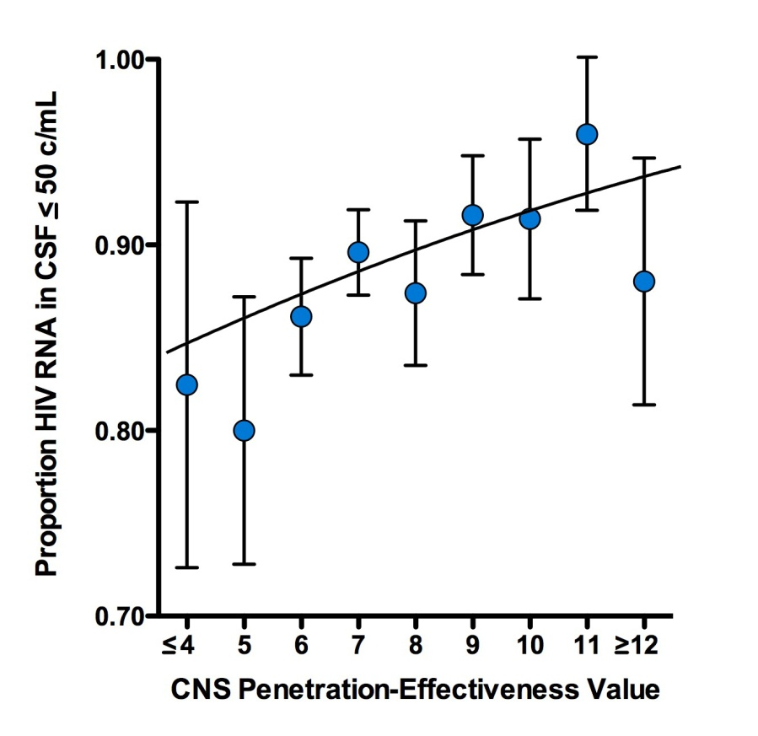
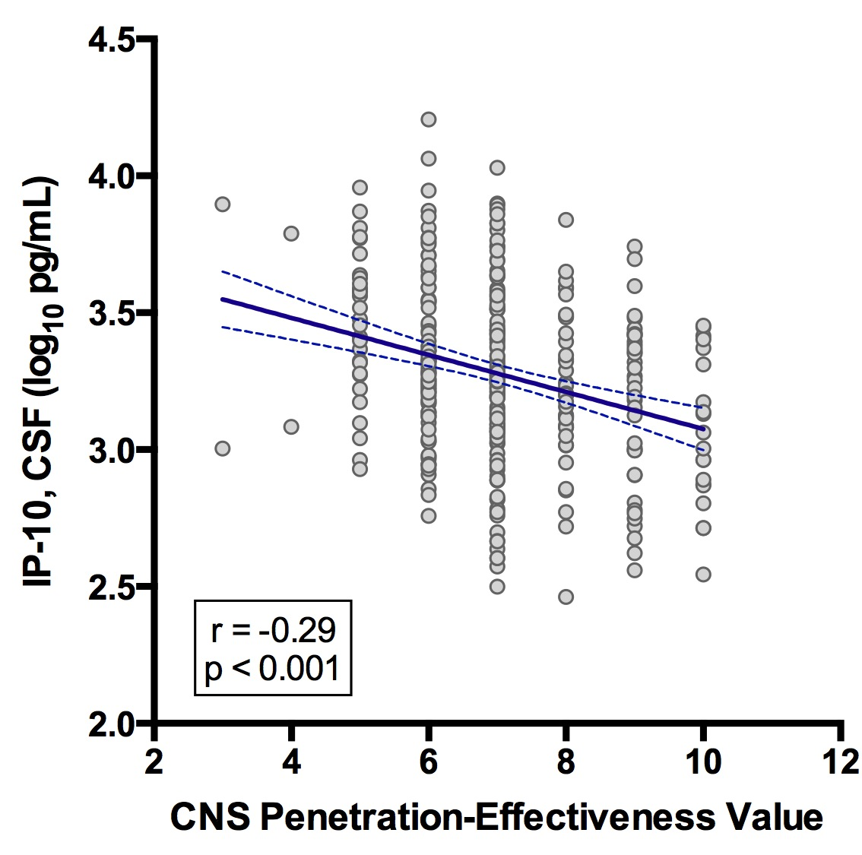
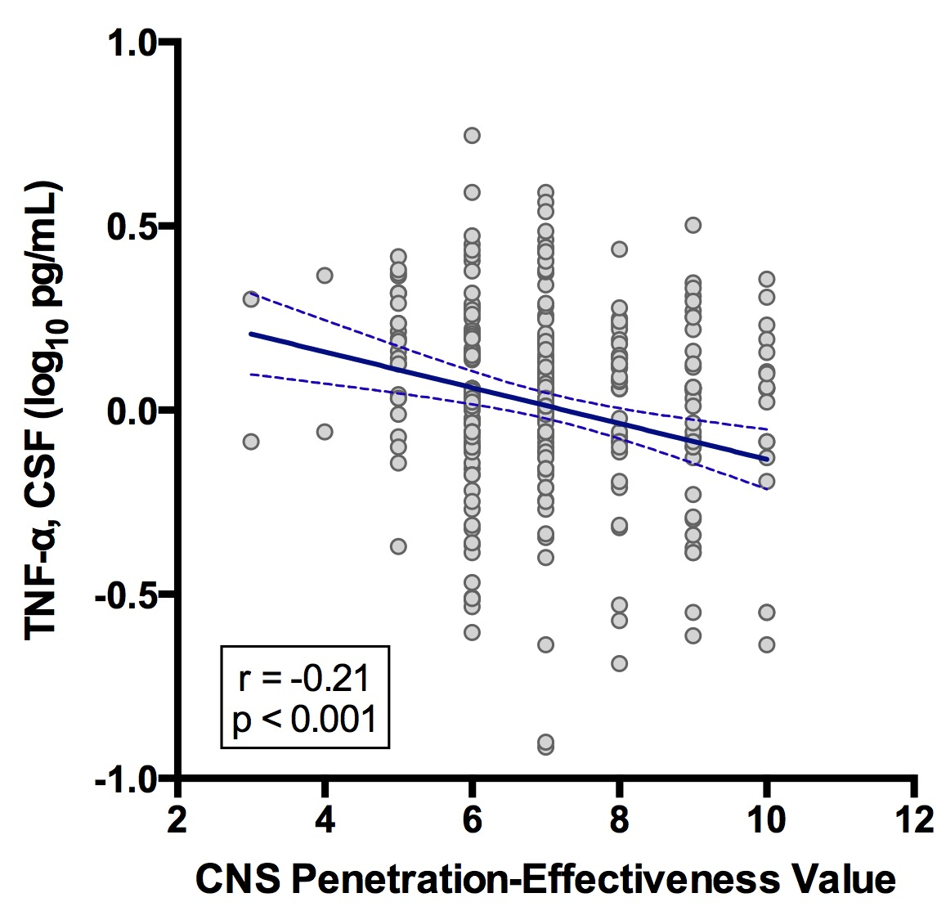
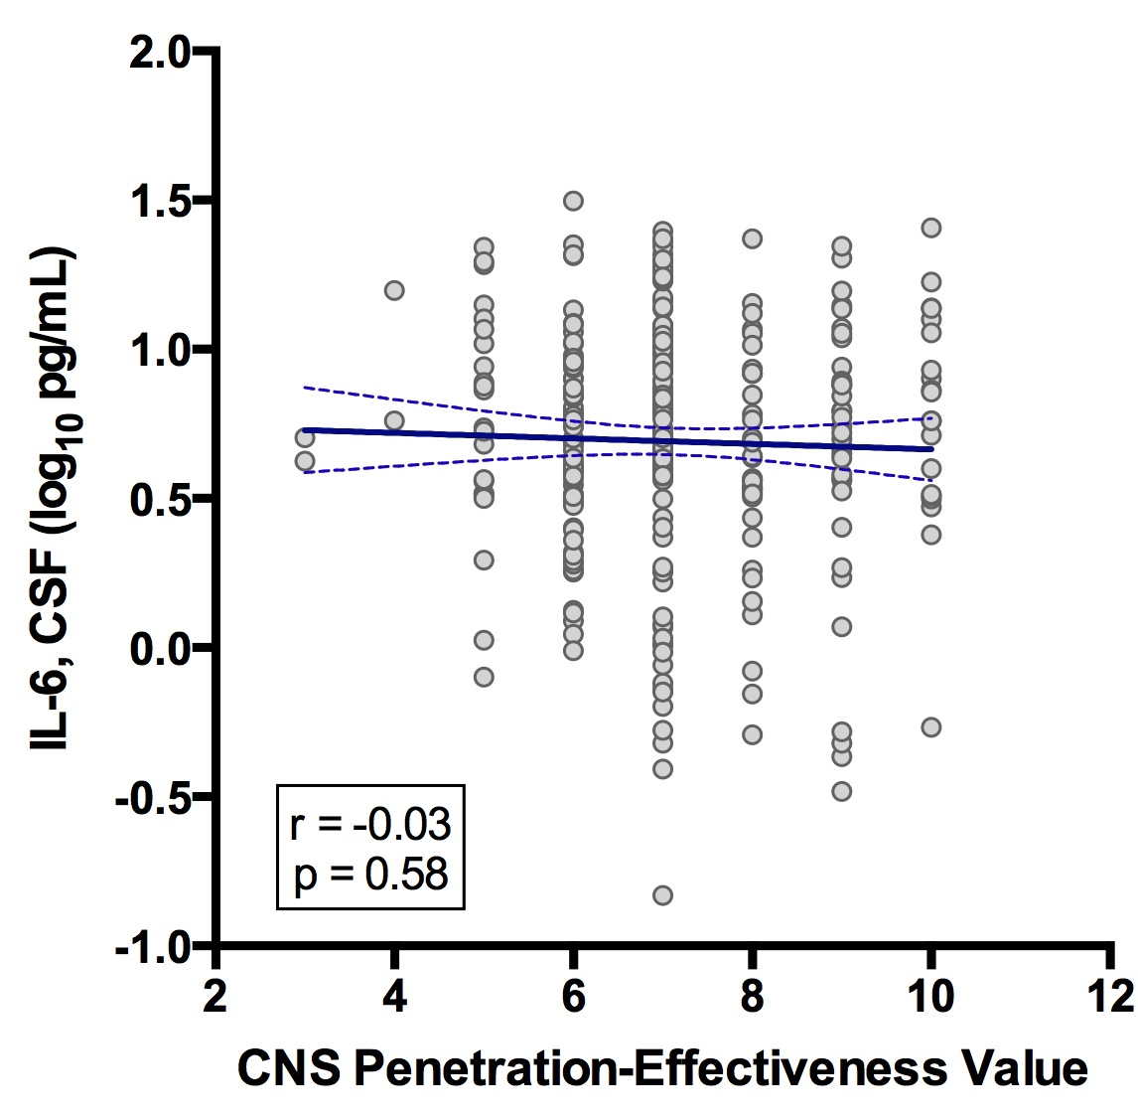
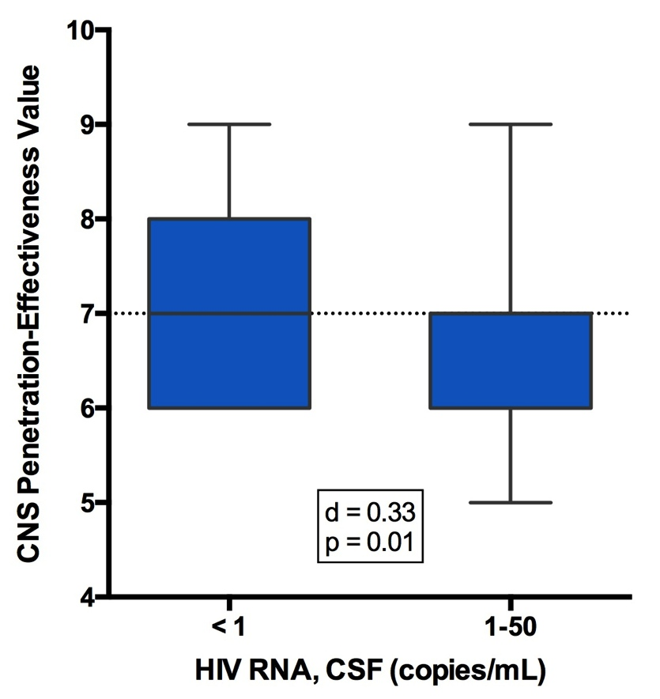
2,207 CSF Viral Loads in
413 Volunteers Over 30 months
CSF Inflammation Biomarkers in
394 Volunteers Taking Suppressive ART
p < 0.001
Letendre et al, 19th CROI,
2012, Abstract 473
Single-Copy Assays
in CSF in
283 Volunteers Taking
Suppressive ART
Model R² = 0.22, p < 0.0001
Letendre et al, 16th CROI,
2009, Abstract 484b
Letendre et al, In Preparation

Slide 26
Ideal Characteristics of Analyses of CNS Effectiveness of ART
Studies should be randomized and longitudinal
Power and duration should be sufficient
Assessments should be standardized and comprehensive
Drug regimen potency and toxicity should be similar
For those that focus on CPE, regimens should have the same number of drugs

Slide 27
Recent Reports Have Mixed Findings
 |  | N | NP | Duration | Principal Finding | Notes
Ciccarelli¹ | C-S | 101 | C | - | Beneficial | 2010 version stronger than 2008 version
Ciccarelli² | C-S | 215 | C | - | Beneficial | Adjusted CPE using GSS
Casado³ | C-S | 69 | B | - | Trend toward benefit | Beneficial when CD4 < 200
Vassallo⁴ | L | 96 | C | 22 months | Beneficial | ~25% were not virologically suppressed
Cross⁶ | L | 69 | C | ~1 year | No association | Binary transformation only
Ellis⁵ | RCT | 49 | C | 16 weeks | No association | Beneficial in subgroup
Wilson⁷ | C-S | 118 | B | - | Detrimental on 2 tests | Binary transformation only Substance users only
Kahouadji⁸ | C-S | 93 | B | - | Detrimental on 1 test | Methodological flaws
Caniglia⁹ | L | 61,938 | N | - | Detrimental | Absolute risk 1.1% vs. 0.9%
C-S = Cross-sectional, L = Longitudinal, RCT = Randomized clinical trial, C = Comprehensive, B = Brief,
N = None, GSS = Genotype Susceptibility Score
¹Ciccarelli et al, Antiviral Therapy 2013, 18: 153-160; ²Ciccarelli et al, 20th CROI 2013, Abstract 405; ³Casado et al, J Neurovirol 2014, 20: 54-61; ⁴Vassallo et al, AIDS 2014, 28(4):493-501; ⁵Ellis et al, Clin Infect Dis. 2014;58(7):1015-22; ⁶Cross et al, S Afr Med J 2013;103(10):758-762; ⁷Wilson et al, J Clin Experim Neuropsych 2013, 35:915-25, ⁸Kahouadji et al, HIV Medicine 2013, 14: 311-5.

Slide 28
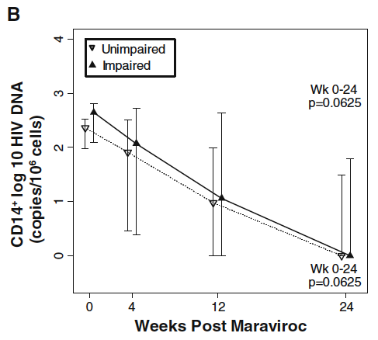
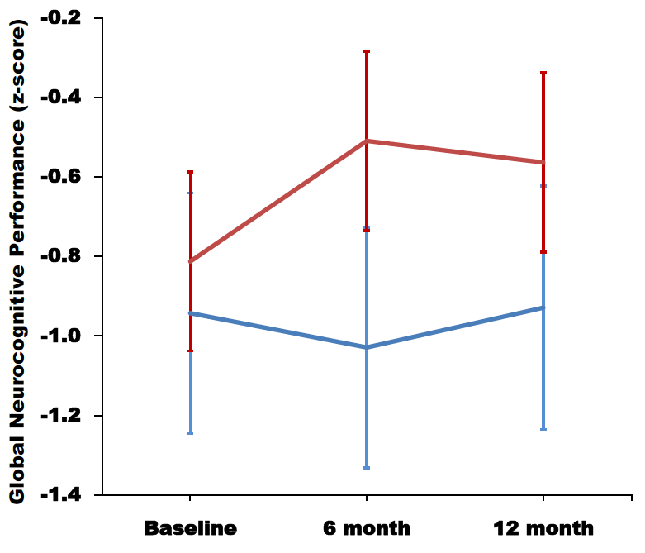
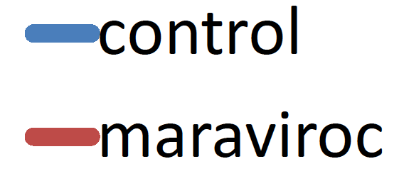
Maraviroc Intensification May Be Beneficial
Open-label, single-arm intensification trial with MVC In 12 adults on suppressive ART
Reduced circulating intermediate and nonclassical CD16-expressing monocytes, monocyte HIV DNA content and sCD163 by 24 weeks
This was associated with significant improvement in NP performance in the 6 subjects who had mild to moderate cognitive impairment.
12 month prospective open-label, randomized, placebo-controlled trial
14 adults on suppressive ART with recent progression to HAND completed the trial
Large effect (d 0.77) at 6-months and moderate effect at 12-months (d 0.55)
Arm x Time interaction: p < 0.05
Glutamate concentration in BG was stable in MA arm but increased in control arm at 12-months
Ndhlovu et al, J Neurovirol. 2014;20(6):571-82
Gates et al, CROI 2015. Abstract 441

Slide 29
Clinical Trial of CNS Penetrating ART to Prevent HAND in China
250 HIV+ Adults
ART Naive, CD4 < 350/mm³
Normal Neurocognitive Performance
Blinded to Treatment Arm: Investigators from US, China CDC, and Beijing University Mental Health Institute
Efavirenz + Tenofovir
+ Lamivudine
R
Open-Label
Nevirapine + Zidovudine
+ Lamivudine
Follow-up: 96 Weeks at 2 Hospitals in Beijing
Safety Assessments & Data Safety Monitoring Board
Standardized Neurocognitive Testing
Functional Assessments
Targeted Pharmacogenetics
Inflammation Biomarkers in Blood
Zhang et al, CROI 2015, Abstract 56

Slide 30
Neurocognitive Methods
An 8-test battery that assessed 5 cognitive abilities was administered at 48 and 96 weeks
Cross-sectional & longitudinal normative data
Adjust for effects of age, gender, and education using data from HIV- adults in China
Summary measures
Primary outcome: Summary Change Score*
Secondary outcomes: Global neurocognitive impairment, Global deficit score
Neurocognitive Test Battery
Hopkins Verbal Learning Test-Revised - Total Learning
Brief Visuospatial Learning Test-Revised - Total Learning
WAIS-III Digit Symbol Test
Grooved Pegboard Test
WMS-III Spatial Span
Action Fluency Test
Paced Auditory Serial Addition Task (PASAT)-50
*Cysique et al, J Clinical Experimental Neuropsychology 2011. 33 (5), 505–522

Slide 31
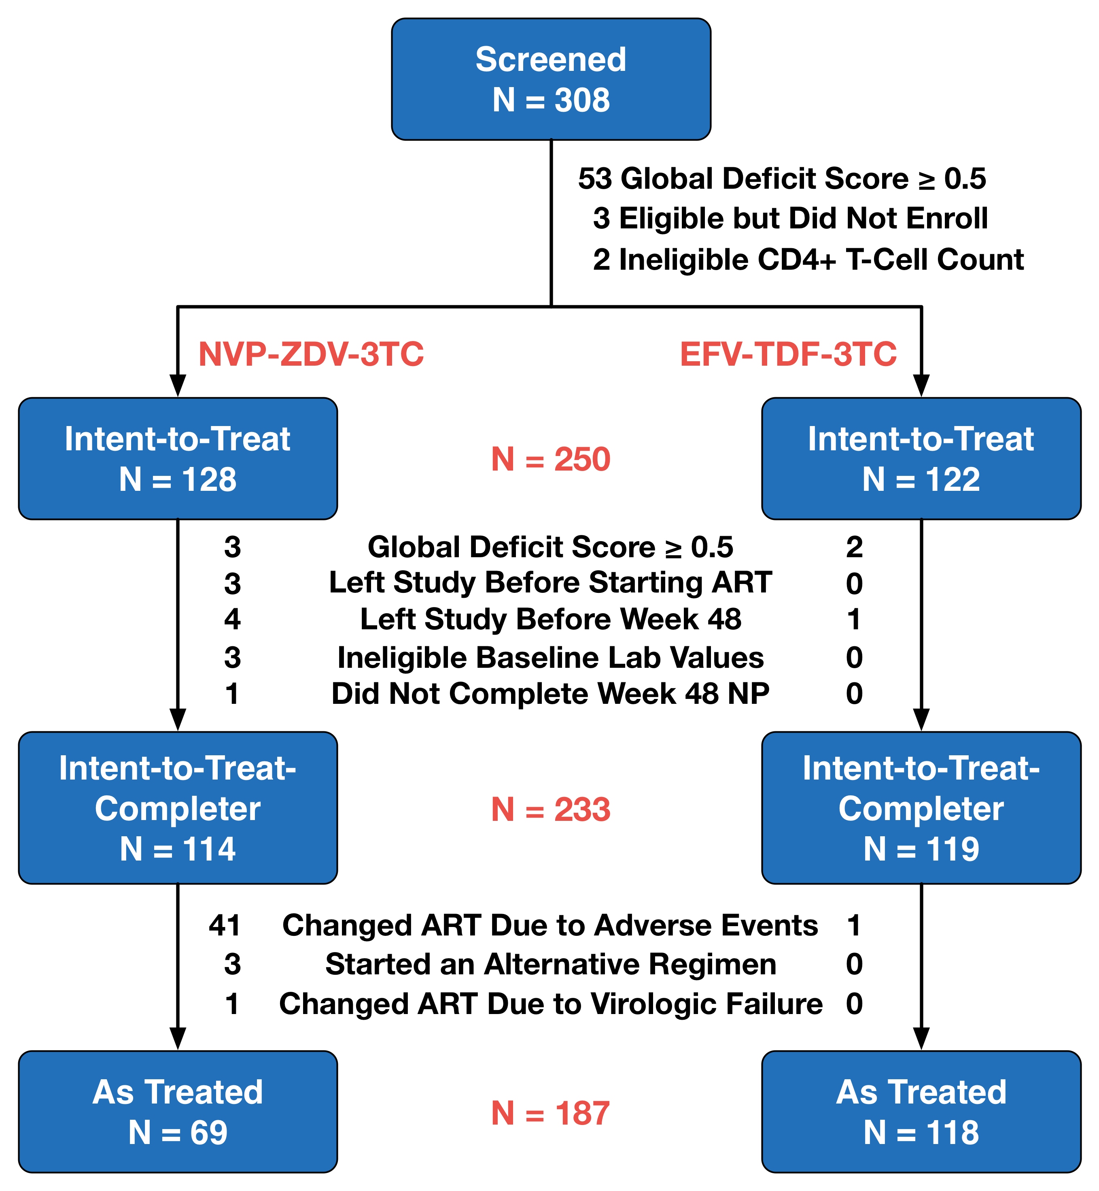

Slide 32
Before Treatment, Arms were Comparable
 | NVP-ZDV-3TC | EFV-TDF-3TC | P Value
Sample Size | 128 | 122 | -
Demographic Characteristics
Age (Years) | 32.9 (7.7) | 31.9 (8.3) | 0.31
Sex (Men) | 124 (97%) | 122 (100%) | 0.12
Ethnicity (Han) | 121 (94.5%) | 116 (95.1%) | 0.84
Education (Years) | 11.6 (3.6) | 11.8 (3.9) | 0.72
Body Mass Index | 22.3 (2.9) | 21.8 (2.5) | 0.16
Disease Characteristics
AIDS Diagnosis | 42 (32.8%) | 39 (32.0%) | 0.89
HIV RNA, Plasma (log₁₀ c/mL) | 4.2 (0.8) | 4.2 (0.9) | 0.78
CD4+ T-cells (/mm³) | 235.1 (89.8) | 222.1 (83.6) | 0.24
CD8+ T-cells (/mm³) | 823.6 (355.7) | 836.2 (439.0) | 0.80
HCV Seropositive | 3 (2%) | 3 (2%) | 0.99
HBV Surface Antigen | 1 (0.8%) | 1 (0.8%) | 0.99
*Values are either mean (SD), median [IQR], or number (%)

Slide 33
Before Treatment, Arms were Comparable
 | NVP-ZDV-3TC | EFV-TDF-3TC | P Value
Sample Size | 128 | 122 | -
Neurocognitive & Mood Characteristics
Global Deficit Score (GDS) | 0.12 (0.15) | 0.14 (0.14) | 0.25
Beck Depression Inventory | 9.8 (7.6) | 9.7 (8.3) | 0.92
Other Lab Characteristics
Total WBC Count (x 10⁹/L) | 5.1 (1.5) | 4.9 (1.3) | 0.55
Hemoglobin (g/dL) | 14.7 (1.1) | 14.8 (1.2) | 0.55
Platelets (x 10⁹/L) | 191 (51) | 187 (46) | 0.57
Alanine Aminotransferase, Serum | 22.9 [16.0, 33.8] | 21.1 [15.0, 30] | 0.24
Total Bilirubin, Serum | 0.12 (0.05) | 0.12 (0.04) | 0.46
Albumin, Serum | 4.7 (0.3) | 4.7 (0.4) | 0.76
Total Protein, Serum | 8.2 (0.5) | 8.2 (0.6) | 0.92
Creatinine, Serum | 0.73 (0.10) | 0.73 (0.11) | 0.68
*Values are either mean (SD), median [IQR], or number (%)

Slide 34
On Treatment, Indicators of Antiviral Efficacy Were Comparable
Week 48 (ITT-Completer)
 | NVP-ZDV-3TC | EFV-TDF-3TC | P Value
Sample Size | 114 | 119 | -
HIV RNA, Plasma (No. (%) ≤ 50 c/mL) | 103 (91.2%) | 109 (91.6%) | 1.00
CD4+ T-cells (/µL) | 396.6 (158.0) | 396.5 (153.4) | 1.00
CD8+ T-cells (/µL) | 789.4 (368.0) | 760.5 (360.8) | 0.54
100% Adherence in Past 4 Days | 113 (99.1%) | 119 (100%) | 0.49
Week 96 (ITT-Completer)
 | NVP-ZDV-3TC | EFV-TDF-3TC | P Value
Sample Size | 112 | 118 | -
HIV RNA, Plasma (No. (%) ≤ 50 c/mL) | 104 (92.0%) | 112 (95.7%) | 0.28
CD4+ T-cells (/mm³) | 447.2 (179.3) | 483.8 (183.8) | 0.13
CD8+ T-cells (/mm³) | 811.3 (322.4) | 850.6 (408.7) | 0.42
100% Adherence in Past 4 Days | 112 (100%) | 116 (100%) | 1.00
*Values are either mean (SD), median [IQR], or number (%)

Slide 35
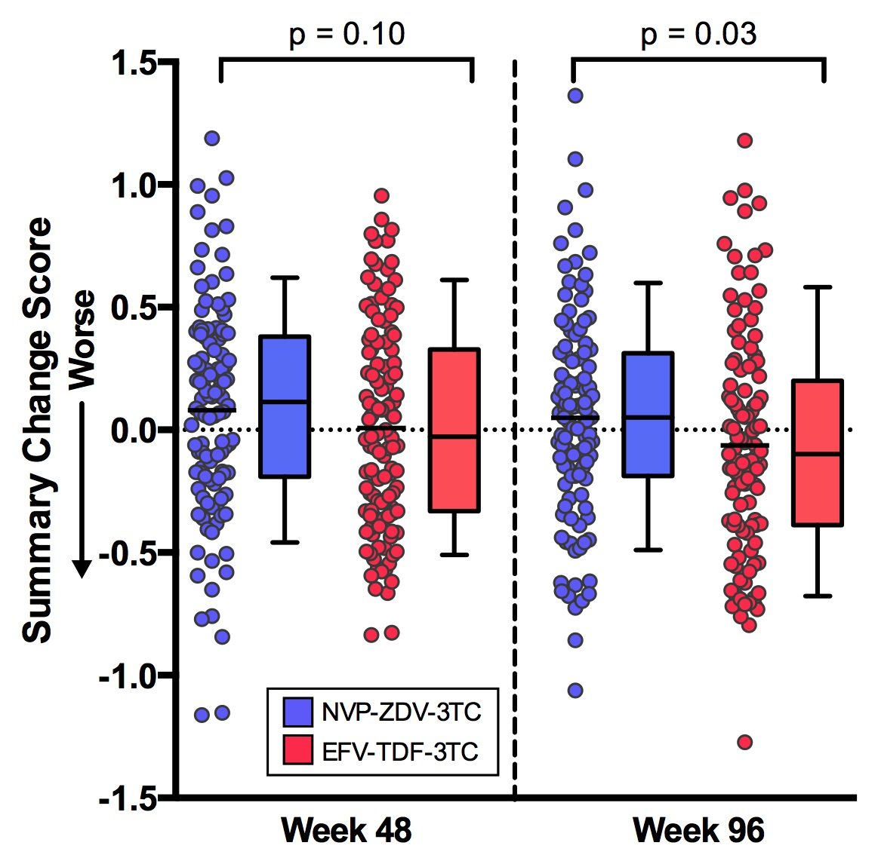
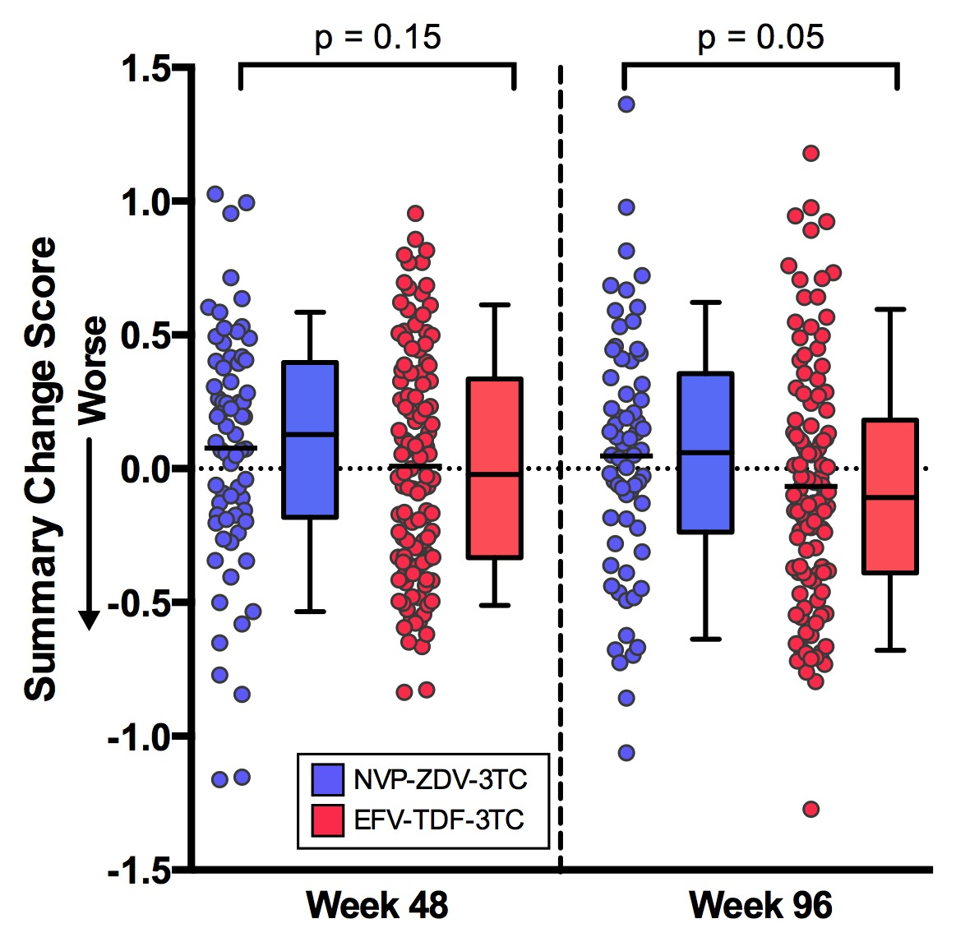
EFV-TDF-3TC Was Associated with Greater Decline After 96 Weeks
ITT-C Analysis, N = 233
As Treated Analysis, N = 187
Zhang et al, CROI 2015, Abstract 56

Slide 36
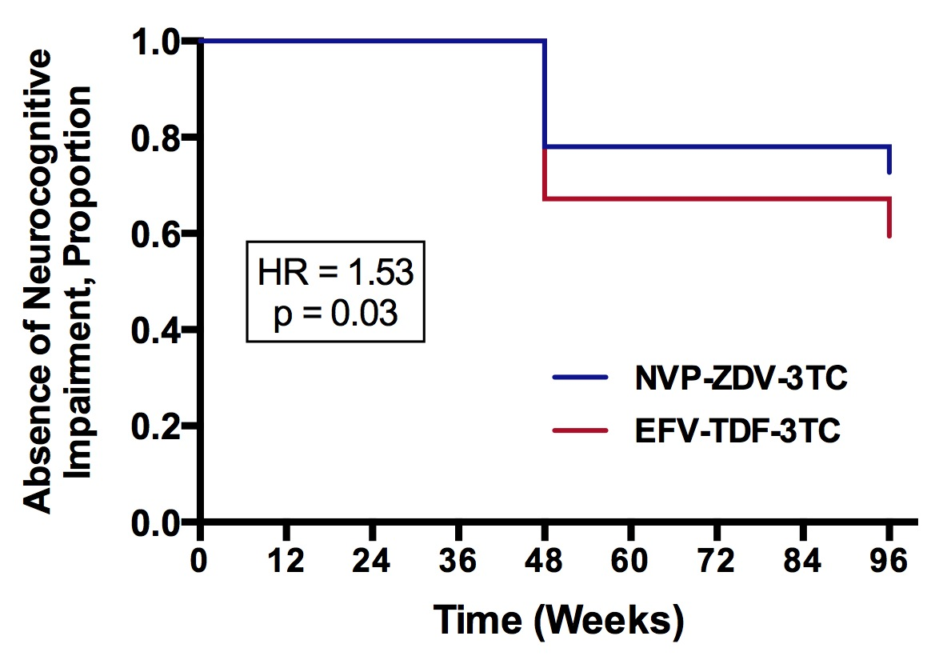
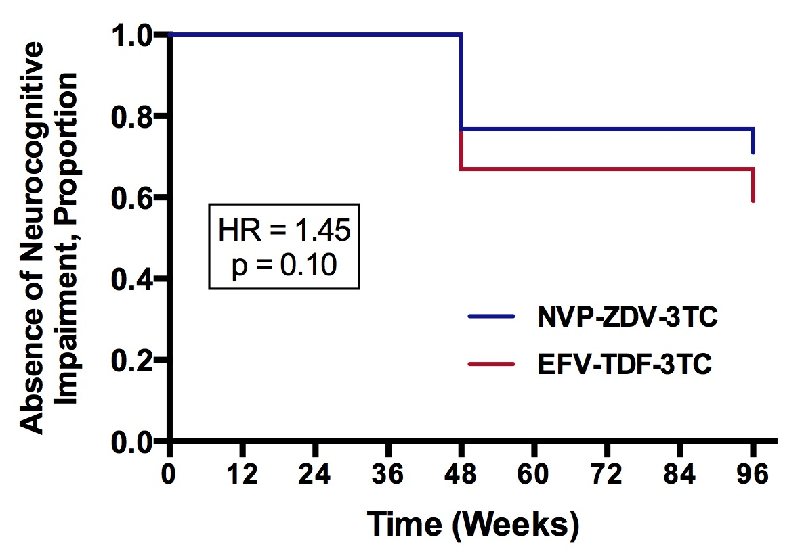
EFV-TDF-3TC Was Associated with Shorter Time-to-Impairment
ITT-C Analysis, N = 233
As Treated Analysis, N = 187
Zhang et al, CROI 2015, Abstract 56

Slide 37
107 Subjects Had at Least One Adverse Event
 | NVP-ZDV-3TC | EFV-TDF-3TC | P value
Subjects with at least 1 Adverse Event* |  |  | < 0.001
 | 66 (57.9%) | 41 (34.4%)
Most Severe Adverse Event Grade* |  |  | 0.006
- Grade 1 | 19 (16.7%) | 25 (21.0%)
- Grade 2 | 15 (13.2%) | 8 (6.7%)
- Grade 3 | 18 (15.8%) | 5 (4.2%)
- Grade 4 | 14 (12.3%) | 3 (2.5%)
Adverse Event-Related Discontinuations* |  |  | < 0.001
 | 41 (32%) | 1 (0.8%)
All Adverse Event-Related Discontinuations Occurred before 28 Weeks
*Denominator is Number of Subjects in the ITT-C Analysis

Slide 38
Liver toxicity, Hypersensitivity, and Bone Marrow Suppression Were More Common with NVP-ZDV-3TC
 | NVP-ZDV-3TC | EFV-TDF-3TC | P value
Elevated ALT or AST | 40 (35.1%) | 23 (19.3%) | 0.008
Rash | 24 (21.0%) | 3 (2.5%) | < 0.001
Neutropenia/Leukopenia | 20 (17.5%) | 5 (4.2%) | 0.001
Fever | 13 (11.4%) | 1 (0.8%) | < 0.001
Anemia | 9 (7.9%) | 0 (0%) | 0.001
Thrombocytopenia | 6 (5.3%) | 5 (4.2%) | 0.76
Hyponatremia/Hypokalemia | 3 (2.6%) | 9 (7.6%) | 0.08
All adverse events were reversible
14 (6.0%) hospitalizations occurred
8 were considered “Definitely Related” to study treatment
No deaths occurred
*Denominator is Number of Subjects in the ITT-C Analysis

Slide 39
Adverse Events and Discontinuations Differed by Site
 | Site 1 | Site 2 | P value
Sample Size | 138 | 95 | -
Subjects with ≥ 1 Adverse Event | 69 (50%) | 38 (40%) | 0.14
Most Severe Adverse Event Grade* |  |  | 0.003
- Grade 1 | 33 (47.8%) | 11 (28.9%)
- Grade 2 | 19 (27.5%) | 4 (10.5%)
- Grade 3 | 10 (14.5%) | 13 (34.2%)
- Grade 4 | 7 (10.1%) | 10 (26.3%)
Discontinuations Per Subject with Adverse Event(s)* |  |  | < 0.001
 | 19/69 (27.5%) | 23/38 (60.5%)
Data Safety Monitoring Board recommended early termination of enrollment at Site 2
*Denominator is Number of Subjects with Adverse Events at each Site

Slide 40
Sites Differed in Other Characteristics
 | Site 1 | Site 2 | P Value
Sample Size | 138 | 95 | -
Demographic Characteristics
Age (Years) | 33.3 (8.6) | 31.4 (7.2) | 0.07
Education (Years) | 9 [9-12] | 14 [9-16] | < 0.001
Sex (Number (%) Men) | 134 (97.8%) | 94 (98.9%) | 0.65
Ethnicity (Number (%) Han) | 133 (96.4%) | 89 (93.7%) | 0.72
HIV Disease Characteristics
AIDS Diagnosis | 51 (21.9%) | 27 (28.4%) | 0.15
HIV RNA, Plasma (log₁₀ c/mL) | 4.2 (0.9) | 4.2 (0.8) | 0.57
CD4+ T-cells (/mm³) | 225.8 (78.9) | 227.4 (85.0) | 0.89
Other Lab Characteristics
Hemoglobin | 14.5 (11.2) | 15.0 (11.0) | < 0.001
Aspartate Transaminase, Serum | 25.0 (8.1) | 22.8 (11.2) | < 0.001
Total Protein, Serum | 8.0 (5.3) | 8.3 (4.9) | < 0.001
*Values are either mean (SD), median [IQR], or number (%)

Slide 41
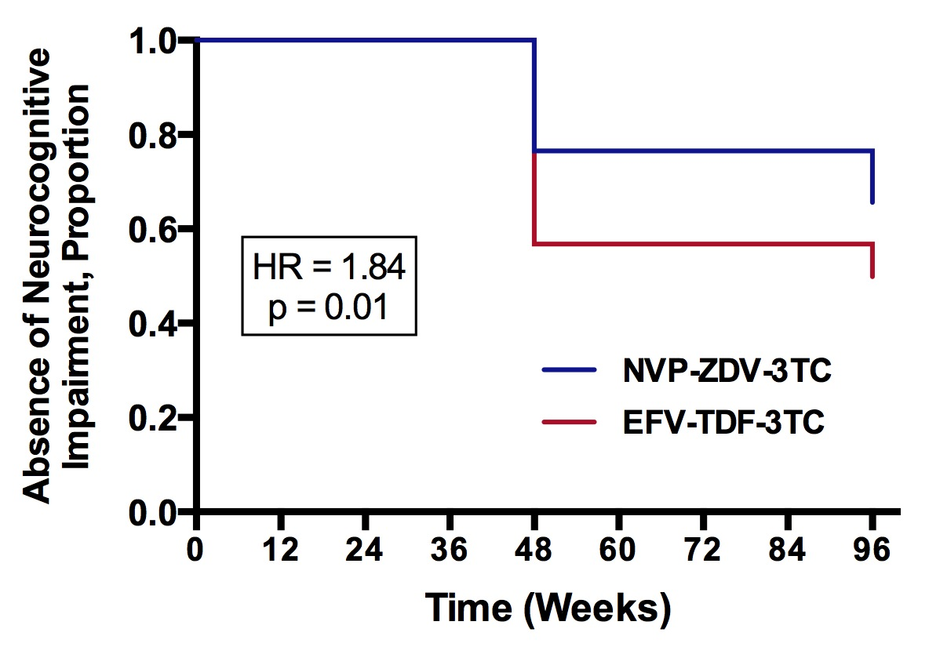
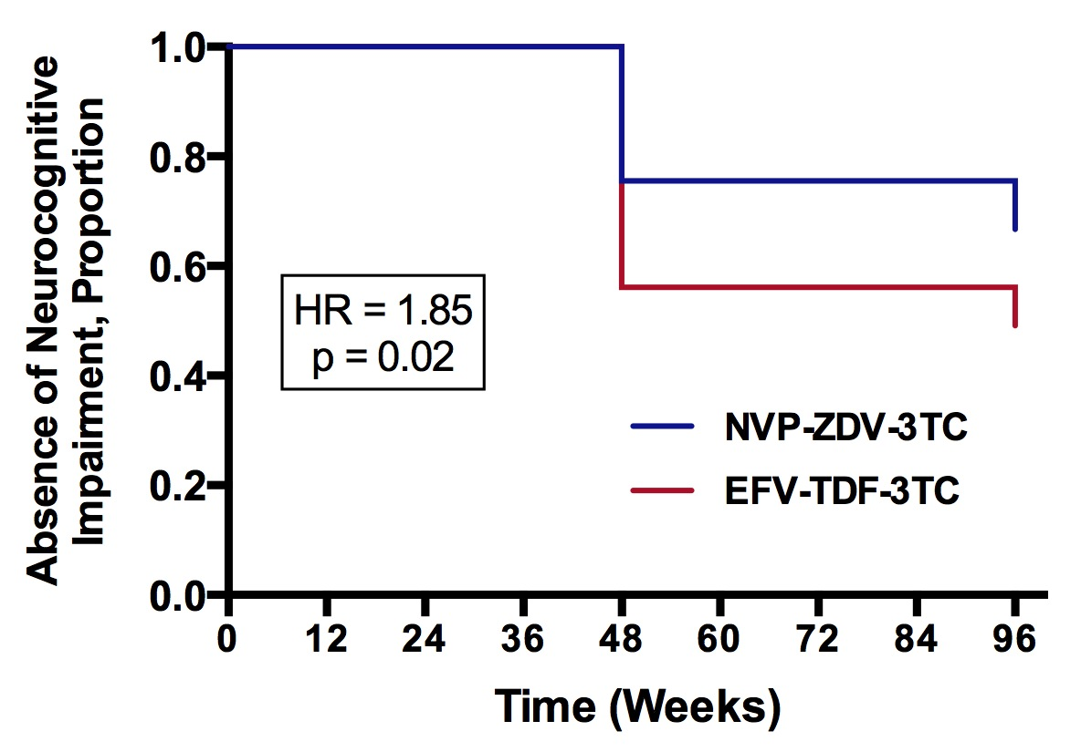
EFV-TDF-3TC Was Associated with Shorter Time-to-Impairment at Site 1
ITT-C Analysis, N = 138
As Treated Analysis, N = 118

Slide 42
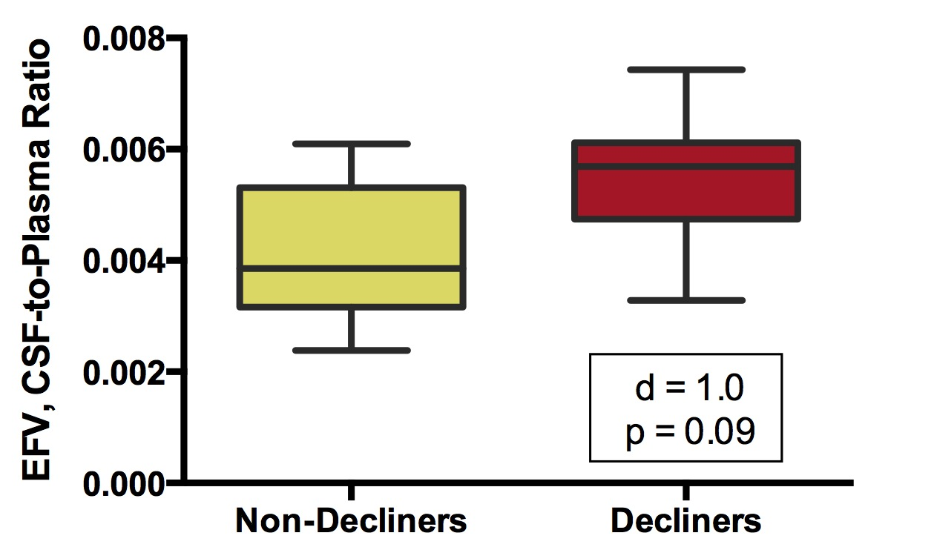
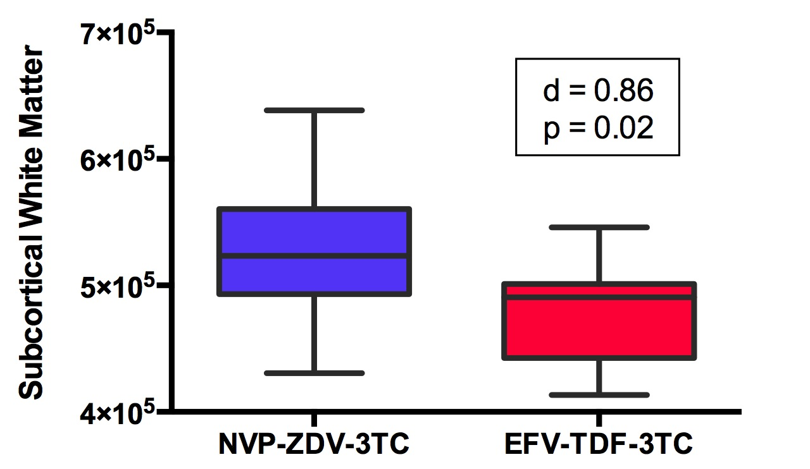
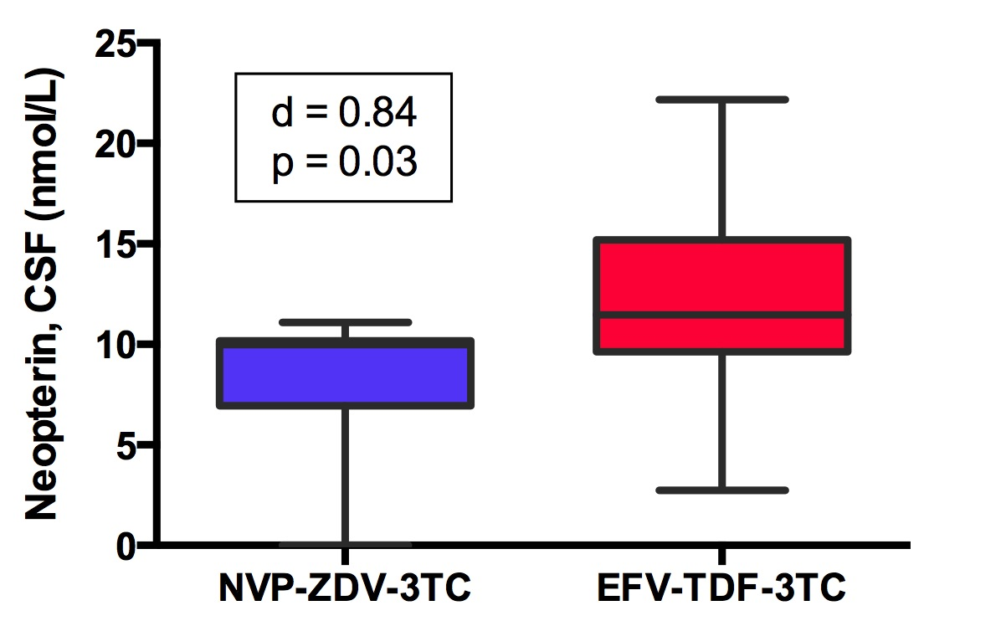
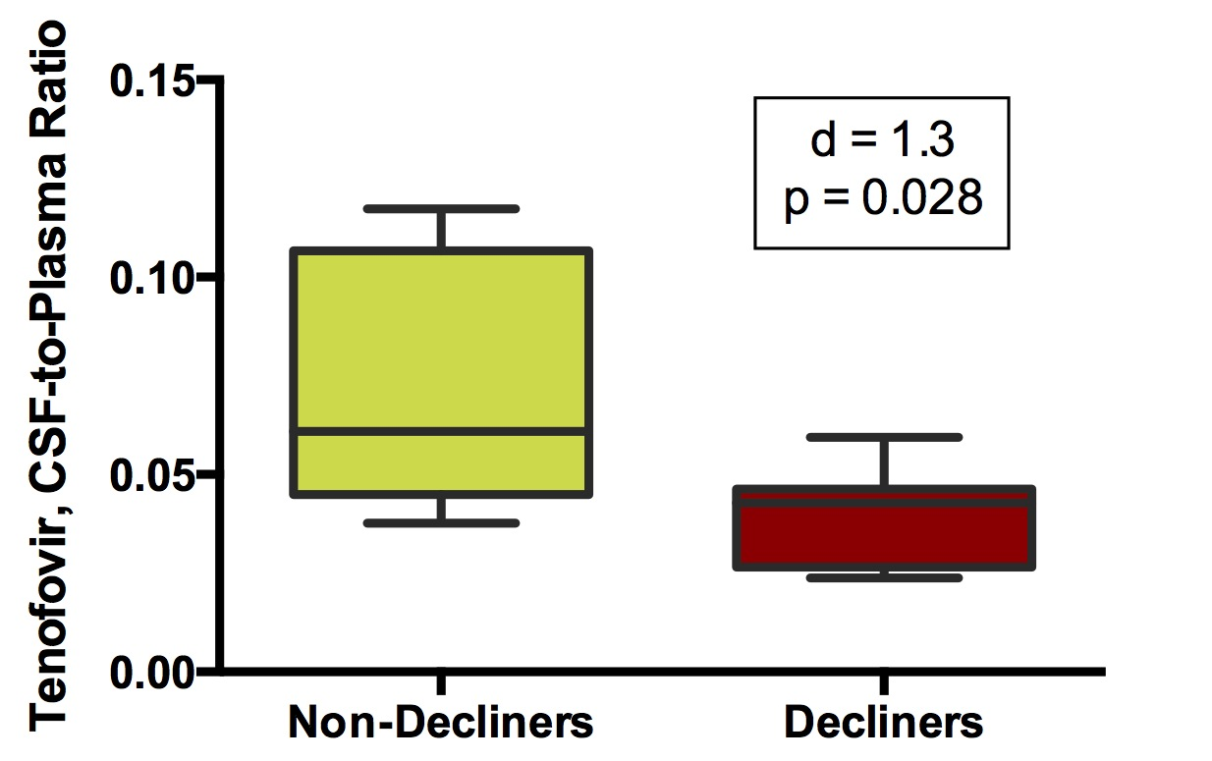
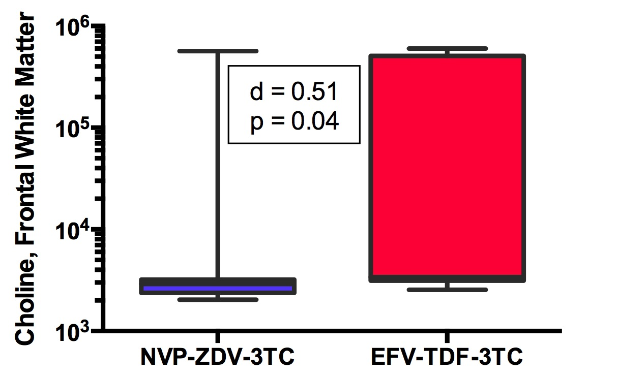
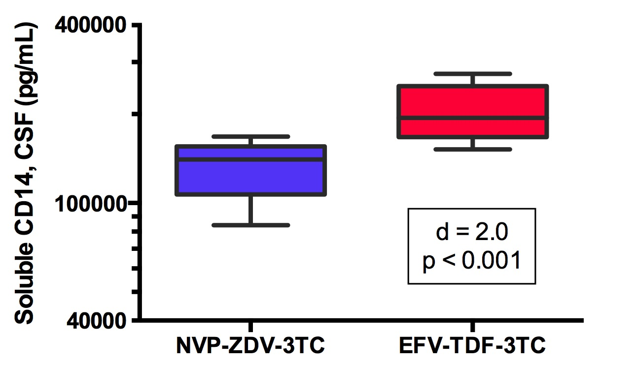
Nested Case-Control Study of 15 Decliners and 15 Matched Non-Decliners
Antiretroviral
Drug Concentrations
Magnetic Resonance
Imaging/Spectroscopy
CSF
Biomarkers
Ma et al, CROI 2015, Abstract 444

Slide 43
DHHS Preferred Regimens (ART Naive)
TDF-FTC
EFV¹
Short- and long-term neurotoxicity
CSF concentrations do not consistently exceed inhibitory concentrations
Associated with CSF viral escape
ATV/r¹
DRV/r
CSF concentrations exceed 50% inhibitory concentrations in all
RAL
CSF concentrations exceed 50% inhibitory concentrations in all
EVG/c
No CSF pharmacokinetic data
RPV²
CSF concentrations do not consistently exceed inhibitory concentrations
DTG
CSF concentrations exceed 50% inhibitory concentrations in all
Fewer CNS side effects than EFV
ABC-3TC
DTG
No CSF ABC pharmacokinetic data on daily dosing
¹May be combined with ABC-3TC when HIV RNA < 100,000 copies/mL; ²In patients with HIV RNA
< 100,000 copies/mL; Last updated 1 May 2014; Available at http://www.aidsinfo.nih.gov/guidelines

Slide 44
US DHHS Preferred Regimens (ART Naive)
TDF-FTC
DRV/r
CSF concentrations exceed 50% inhibitory concentrations in all
RAL
CSF concentrations exceed 50% inhibitory concentrations in all
EVG/c
No CSF pharmacokinetic data
DTG
CSF concentrations exceed 50% inhibitory concentrations in all
Fewer CNS side effects than EFV
ABC-3TC
No CSF ABC pharmacokinetic data on daily dosing
Removed
EFV
Short- and long-term neurotoxicity
CSF concentrations do not consistently exceed inhibitory concentrations
Associated with CSF viral escape
ATV/r
RPV
CSF concentrations do not consistently exceed inhibitory concentrations
Last updated 8 April 2015; Available at http://www.aidsinfo.nih.gov/guidelines

Slide 45
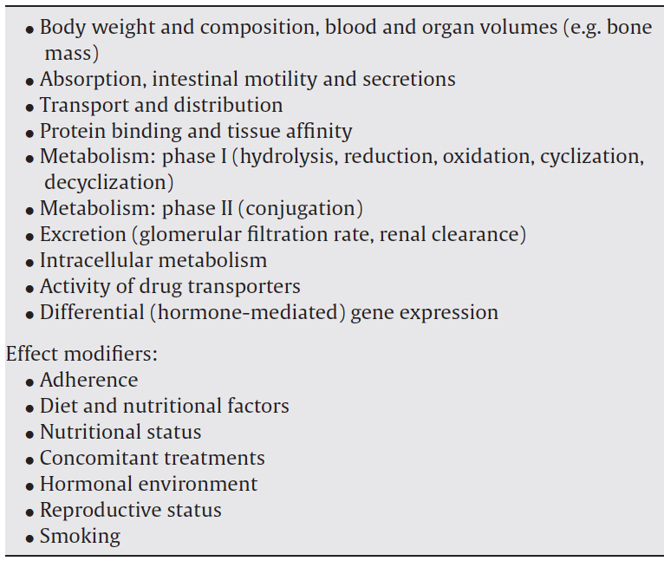
Women May Have Different Exposure of Some ART Drugs Than Men
Reviews of ART pharmacokinetics indicate that women can have higher drug exposure
Difference exists for:
Zidovudine
Lamivudine
Ritonavir-Boosted PIs
Mixed data for non-nucleoside RTIs
Floridia et al, Pharmacological Research 2008, 58:173–182
Ofotokun et al, Gender Medicine, 4(2):106-

Slide 46
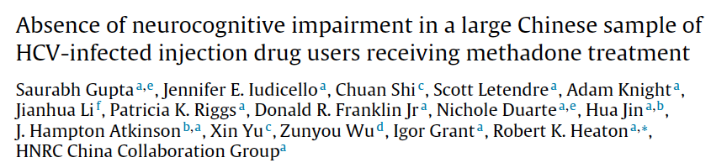
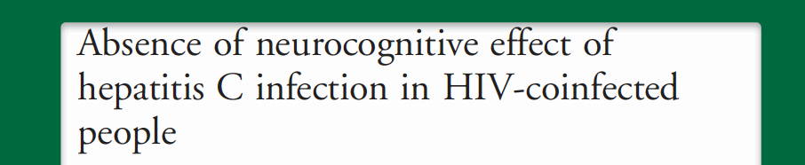
HCV may not be as clear a risk factor for HAND as once thought

Slide 47


HCV Co-Infection May Alter the Relation-ship Between ART Drugs & the CNS
Letendre et al, CROI 2013, Abstract 407

Slide 48


ART Drugs May Alter the Relationship Between HCV Co-Infection & the CNS
Letendre et al, CROI 2013, Abstract 407

Slide 49


Protease Inhibitor Use is Associated with Cerebral Small Vessel Disease
144 adults with HIV/AIDS who died between 1999 and 2011 and had been evaluated prior to death in the California NeuroAIDS Tissue Network
Protease inhibitor use was associated with cerebral small vessel disease
Mild: OR 2.8 (95% CI 1.03–7.9)
Moderate-severe: 2.6 (95% CI 1.03–6.7)
Mild CSVD was associated with HAND
OR 4.8 (95% CI 1.1–21.2)
Soontornniyomkij et al, AIDS 2014, 28:1297–1306
Notes:
ARVs themselves may become a “comorbid” factor potentially contributing to accelerated aging and HAND
(Soontornniyomkij et al, 2014)

Slide 50
ART Drug Concentrations in Brain: Regional Variation, CSF Comparability
 | n | Overall Mean | WM mean (ng/mL) | GP mean (ng/mL) | CGM mean (ng/mL) | CSF (ng/mL)
Concentrations Similar to Historical CSF Concentration
Atazanavir (ATV) | 2 | < 25 | < 25 | < 25 | < 25 | 10.3¹
Efavirenz (EFV) | 2 | 38.6 | 45.2 | 34.8 | 35.9 | 15.6²
Emtricitabine (FTC) | 4 | 181.3 | 230.4 | 173.2 | 140.3 | 109.0³
Lamivudine (3TC) | 3 | 196.9 | 205.5 | 209.8 | 175.4 | 107.8⁴
Concentrations in White Matter Higher than Historical CSF Concentration
Lopinavir (LPV) | 4 | 153.3 | 410.6 | < 25 | < 25 | 16.8⁵
Concentrations Higher than Historical CSF Concentration
Tenofovir (TDF) | 6 | 206.0 | 220.0 | 212.1 | 185.8 | 5.5⁶
WM = White Matter; GP = Globus Pallidus (Deep Gray Matter); CGM = Cortical Gray Matter
Across all drugs, concentrations were lower in CGM
than in the other two regions (p=0.01, paired signed rank test)

Slide 51
Summary
More HIV+ adults may have symptomatic HAND than previously appreciated
Aging and perhaps sex appear to alter the presentation of HAND
In China, EFV-TDF-3TC was associated with earlier neurocognitive decline
Primarily at one of the two sites
Treatment guidelines have tended to move toward ART drugs that are less neurotoxic
Maraviroc intensification may have promise
Protease inhibitors may accentuate CNS damage from HCV

Slide 52


Slide 53






Acknowledgements & Conflicts
Study Volunteers
Esteban
Martinez
Jordi
Blanch
Jose Muñoz
Moreno
UC San Diego
Ronald J. Ellis
David Moore
Tom Marcotte
Cris Achim
Eliezer Masliah
J. Allen McCutchan
Bob Heaton
Igor Grant
Barcelona
Ana Curiel
Ruth Boza
U.S. National Institutes of Health
Industry
Abbvie
Cipla
Gilead Sciences
Janssen
Merck, Inc.
ViiV Healthcare
Brookie Best
Edmund Capparelli
Davey Smith
Mariana Cherner
Debra Rosario
Ben Gouaux
Jennifer Marquie
Donald Franklin

Slide 54
Laboratory Measures of Activities of Daily Living
Finances (budget, pay bills, manage checkbook)
Shopping (from memory and with list)
Meal Planning and Preparation
Restaurant Scenario
Medication Management
Standardized Work Samples

Slide 55


Design
Data from 61,938 patients combined from 9 independent HIV cohorts from Europe and the U.S.
Patients were evaluated prior to ART initiation between 1998 and 2013
“Intent-to-treat” analysis
CPE transformed into 3 categories
“Low”: ≤ 7
“Medium”: 8-9
“High”: ≥ 10
Findings
235 “HAD” events in 259,858 person-years of follow-up
1 per 1106 person-years
“High” CPE group had a 74% increased hazard ratio of “HAD”
Caniglia et al, Neurology 2014;83:1–8; Berger & Clifford, Neurology 2014;83:1–2

Slide 56
Did not use standardized assessments for diagnosing “HAD”
“…diagnostic procedures that reflect standard clinical practice”
The categorical transformation of CPE is unusual
Only 8.8% were in the “high CPE” group
No statistically significant association was found with CPE when analyzed continuously or as a 4-category variable
The between-group difference in absolute risk is not clinically meaningful: 1 “HAD” case per > 4,500 person-years of follow-up
Does not account for factors that were associated with:
Changes in ART over time: 68% changed their initial regimen during observation
“High” CPE regimens: more than 3 antiretroviral drugs, initiation of ART prior to 2004
Non-HIV causes of neurocognitive disease: psychiatric disease, substance use, co-infections
Caniglia et al, Neurology 2014;83:1–8; Berger & Clifford, Neurology 2014;83:1–2

Slide 57
Reasons for Greater Risk for Cognitive & Mood Disorders in HIV+ Women
Social, financial and healthcare disadvantage
Stress due to sexual violence and food insecurity
Comorbid conditions, e.g., metabolic syndrome, drug use, depression
Co-infections, e.g., CMV, HPV, STIs
Differences in immune responses, inflammation, and oxidative stress
Impact of sex hormones: Pregnancy and Menopause
Differences in pharmacology and toxicity of ART and other drugs

